Slide 1
Electricity Coupled with the Heating and Transport Sector
Electricity Mismatch Analysis

Slide 2
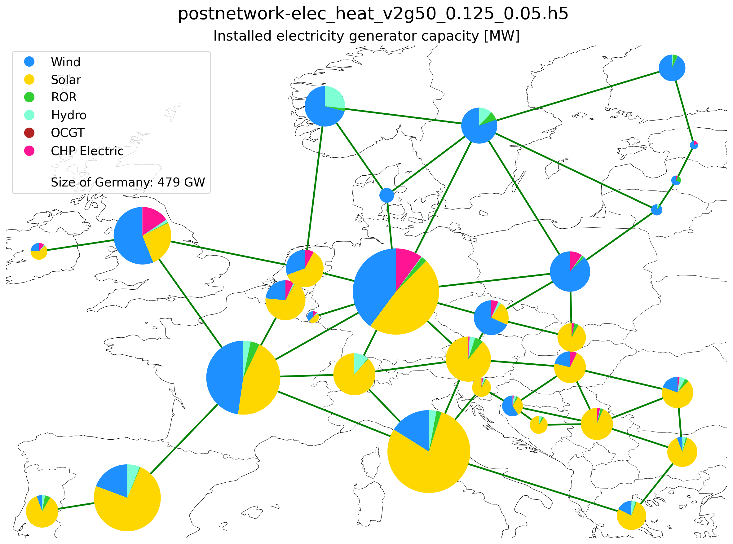
Installed capacity (95% CO2 reduction)

Slide 3
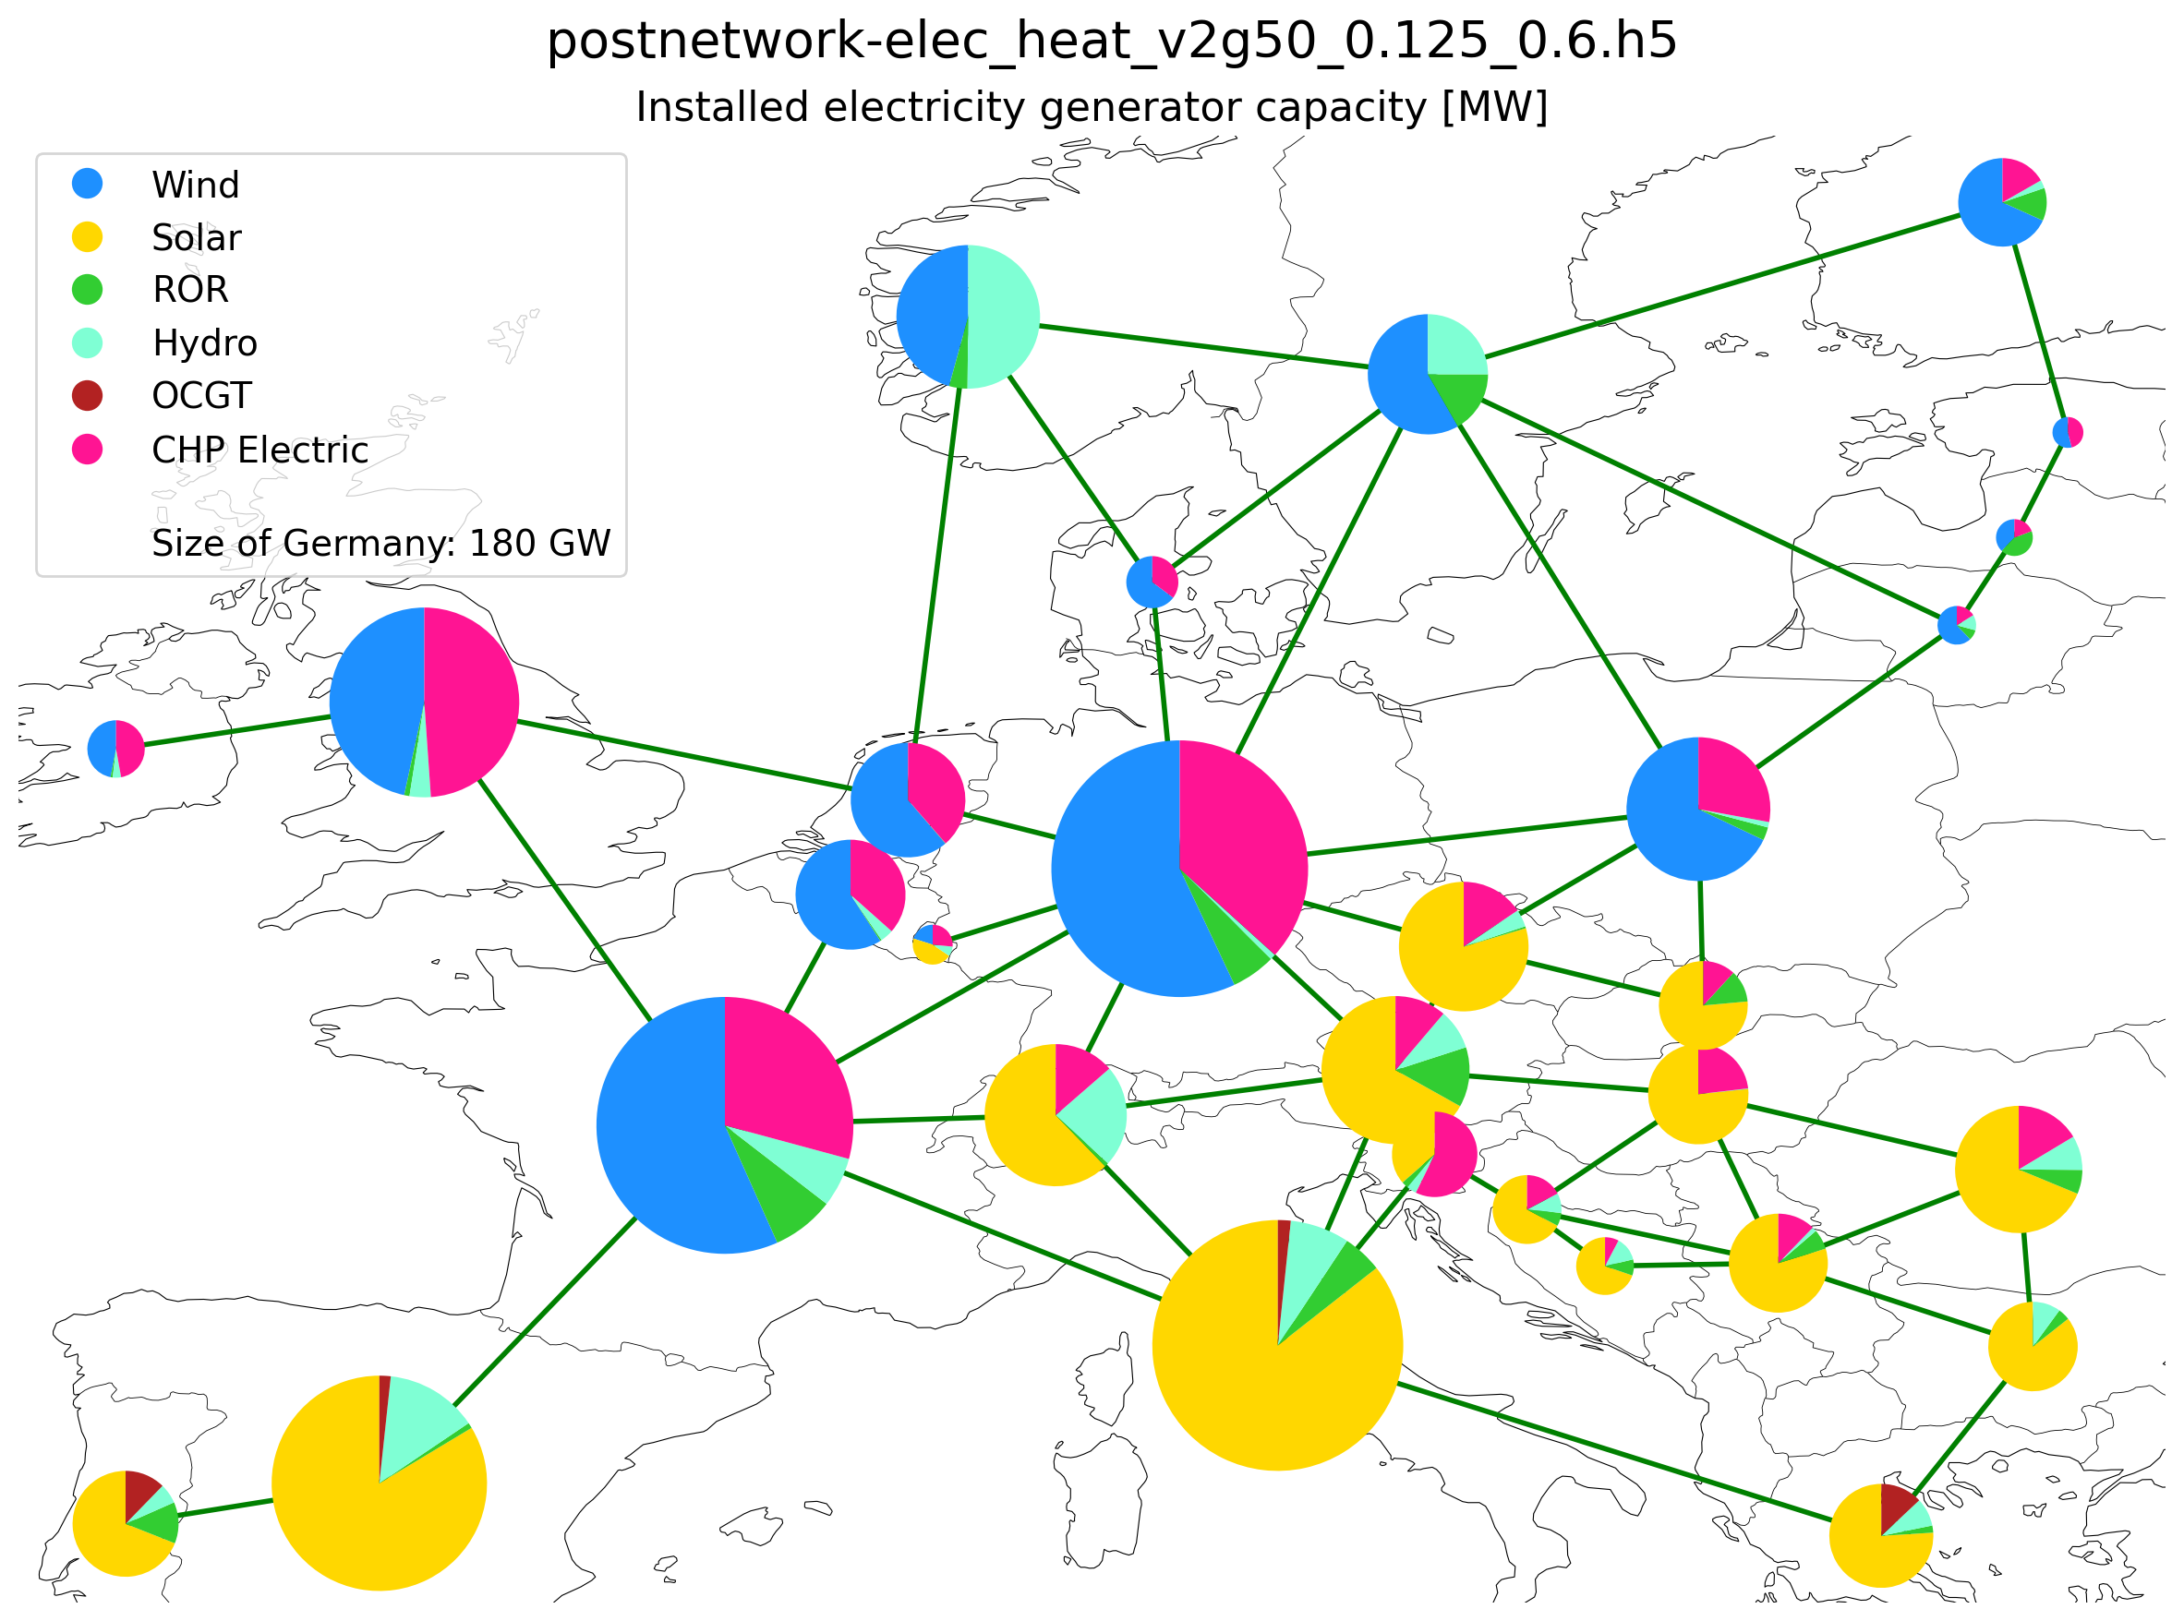

Installed capacity -
40% CO2 reduction
Installed capacity -
50% CO2 reduction

Slide 4
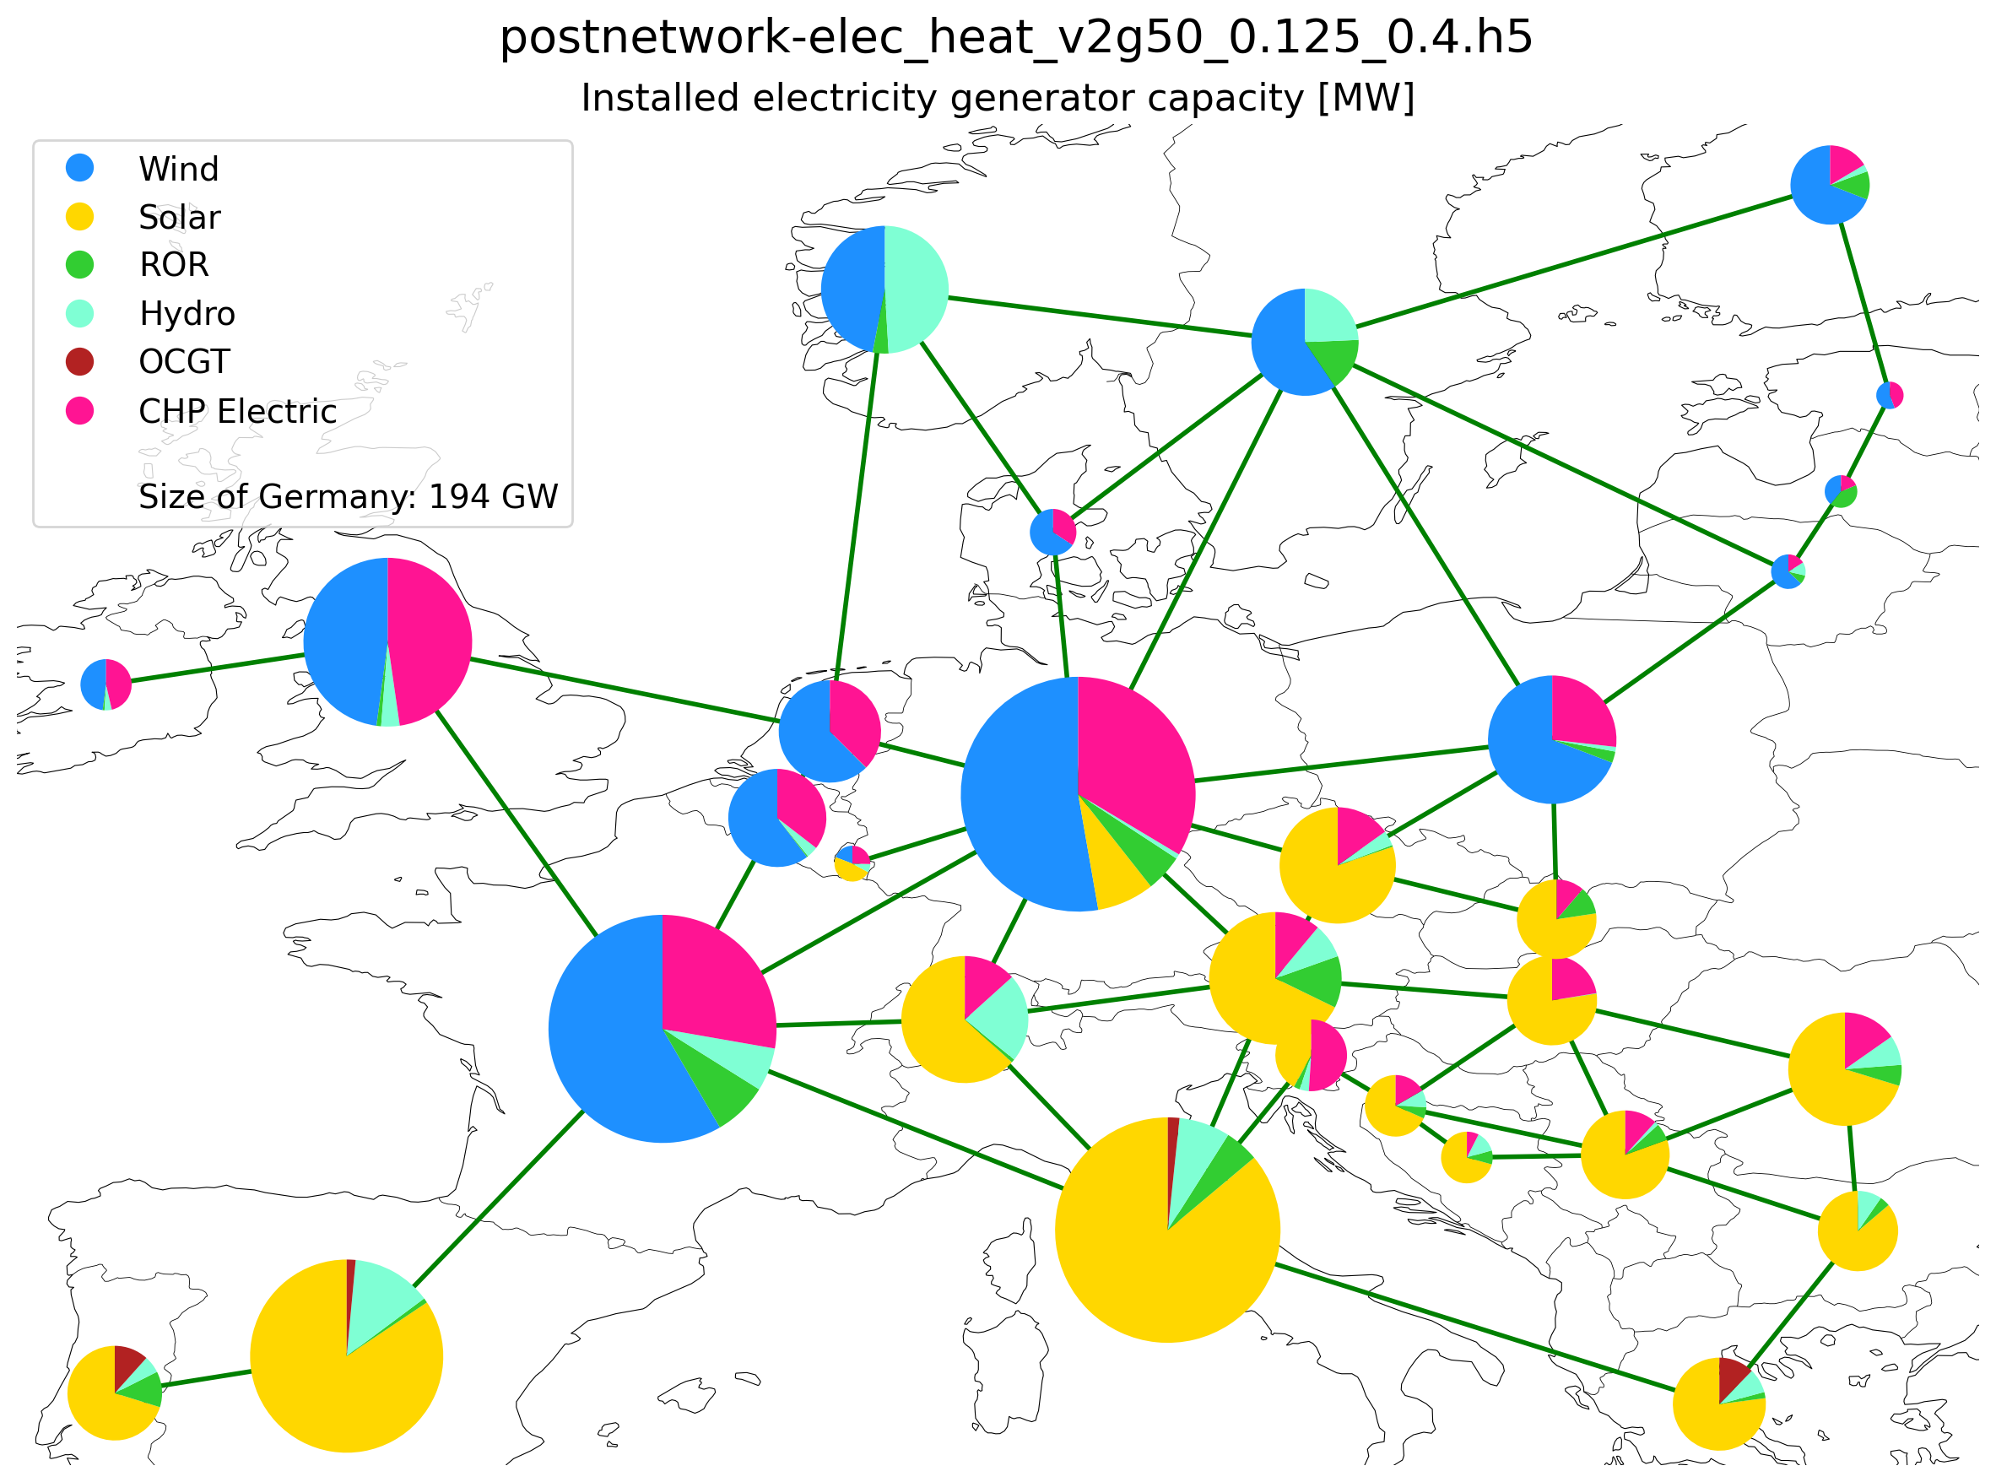
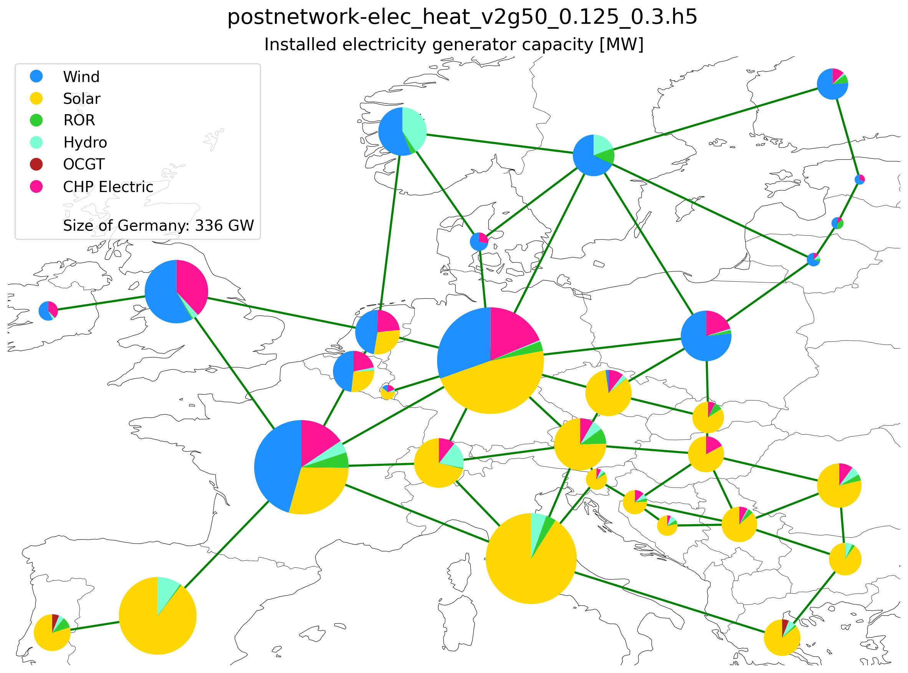
Installed capacity -
60% CO2 reduction
Installed capacity -
70% CO2 reduction

Slide 5
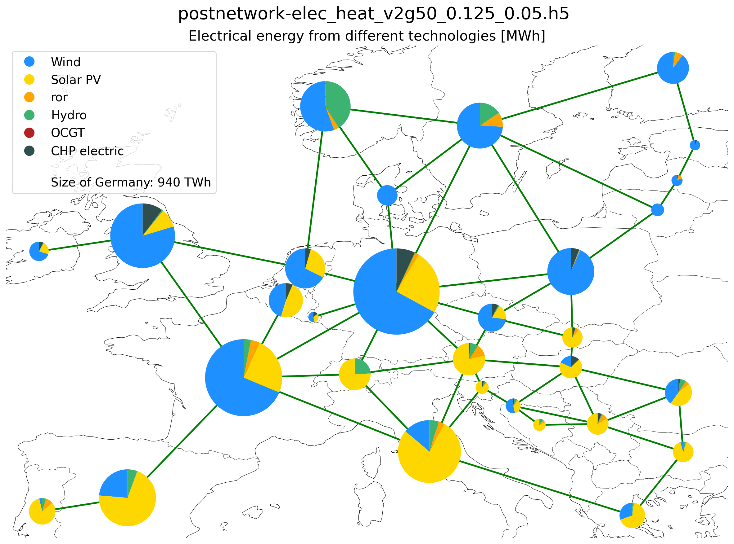
Electricity Supplied by Different Technologies (95% CO2 reduction)

Slide 6
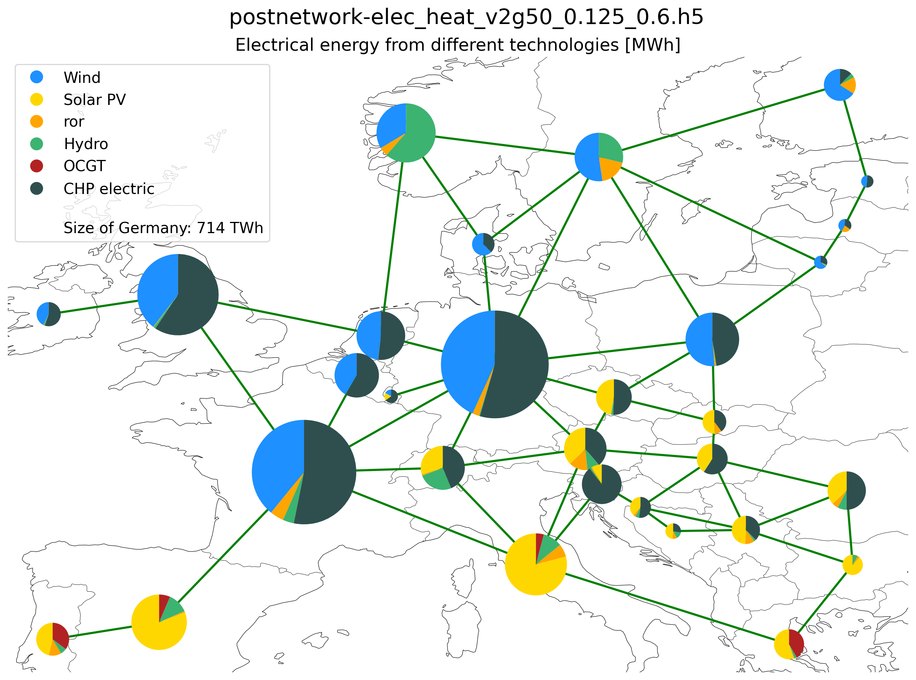

Electricity Supply -
40% CO2 reduction
Electricity Supply -
50% CO2 reduction

Slide 7

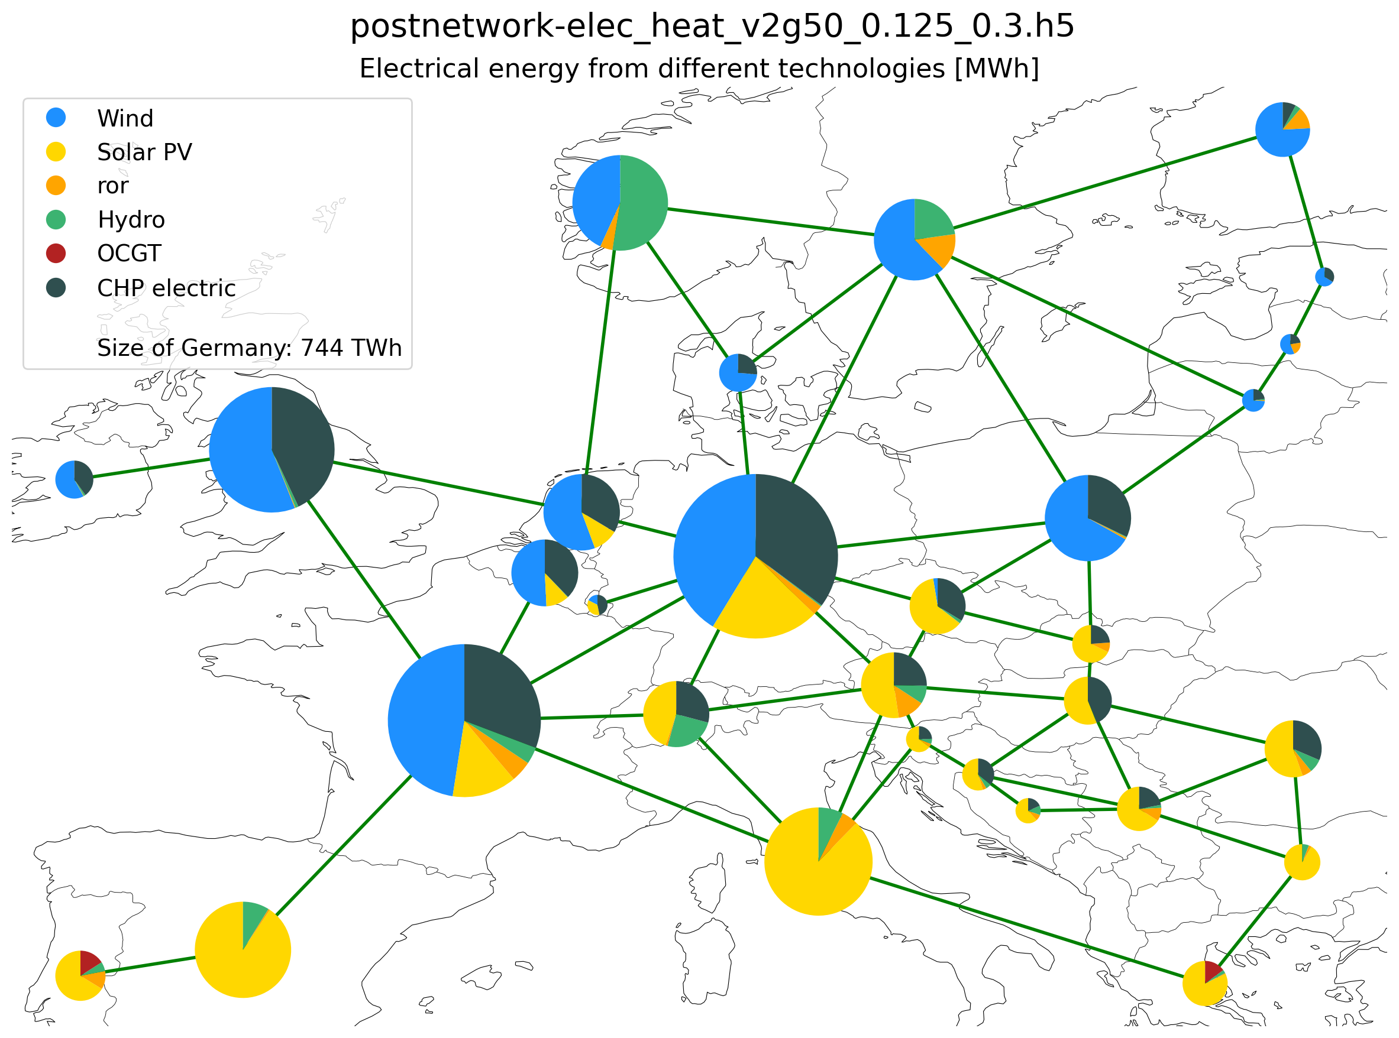
Electricity Supply -
60% CO2 reduction
Electricity Supply -
70% CO2 reduction

Slide 8
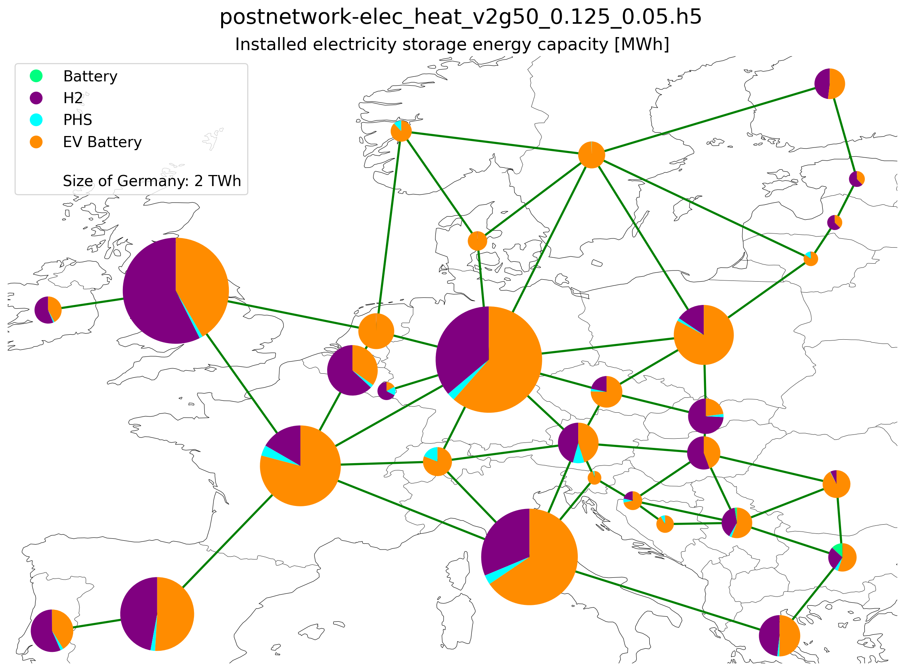
Installed storage (energy capacity) (95% CO2 reduction)

Slide 9
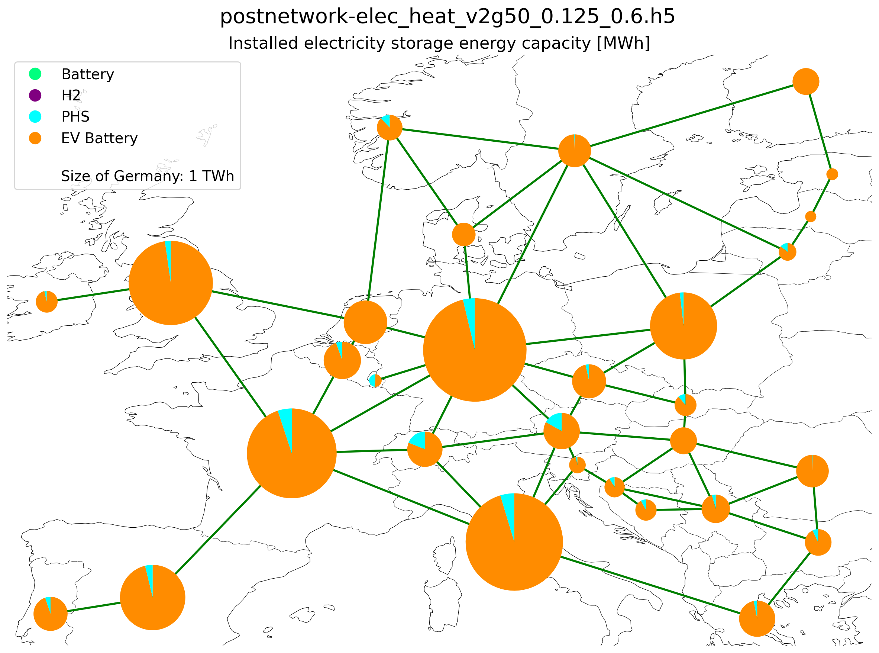

Electricity Storage Capacity -
40% CO2 reduction
Electricity Storage Capacity -
50% CO2 reduction

Slide 10


Electricity Storage Capacity -
60% CO2 reduction
Electricity Storage Capacity -
70% CO2 reduction

Slide 11
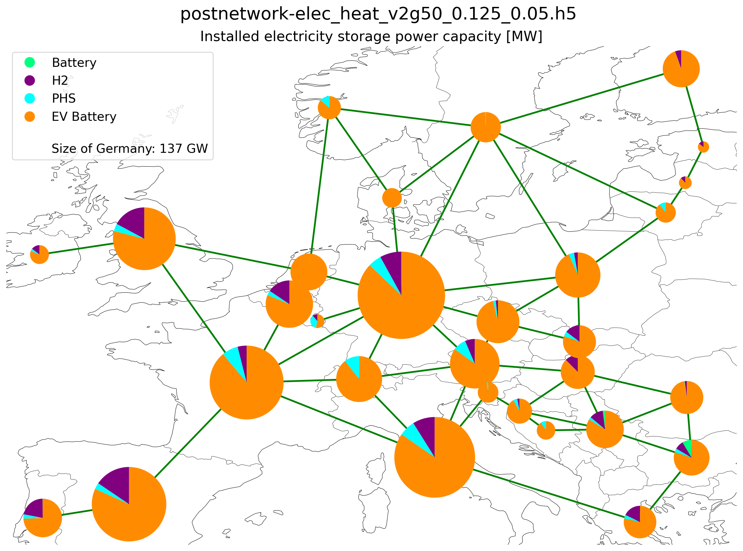
Installed storage (power capacity) (95% CO2 reduction)

Slide 12
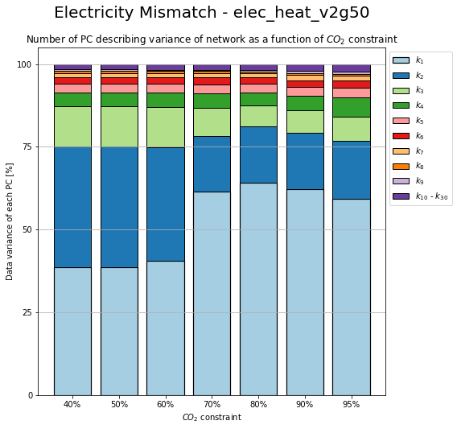
Change in PC due to CO2 Constrain

Slide 13
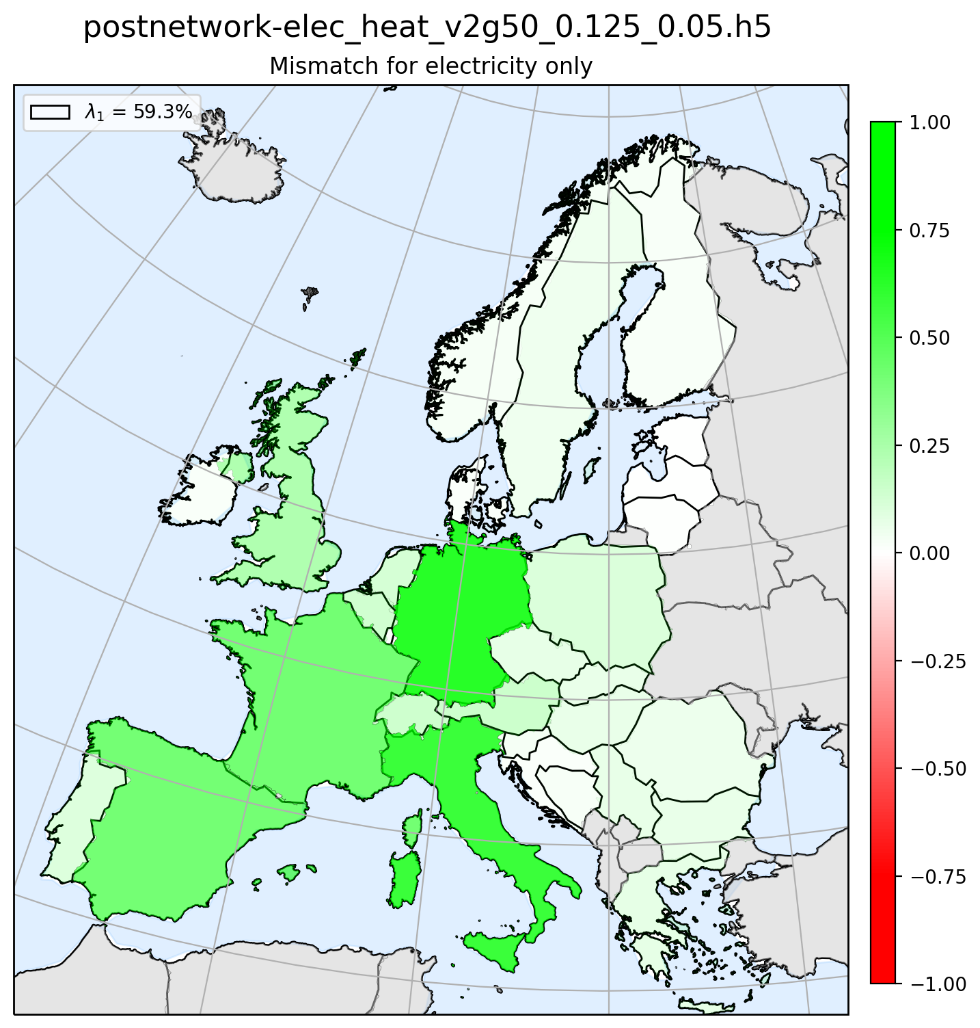
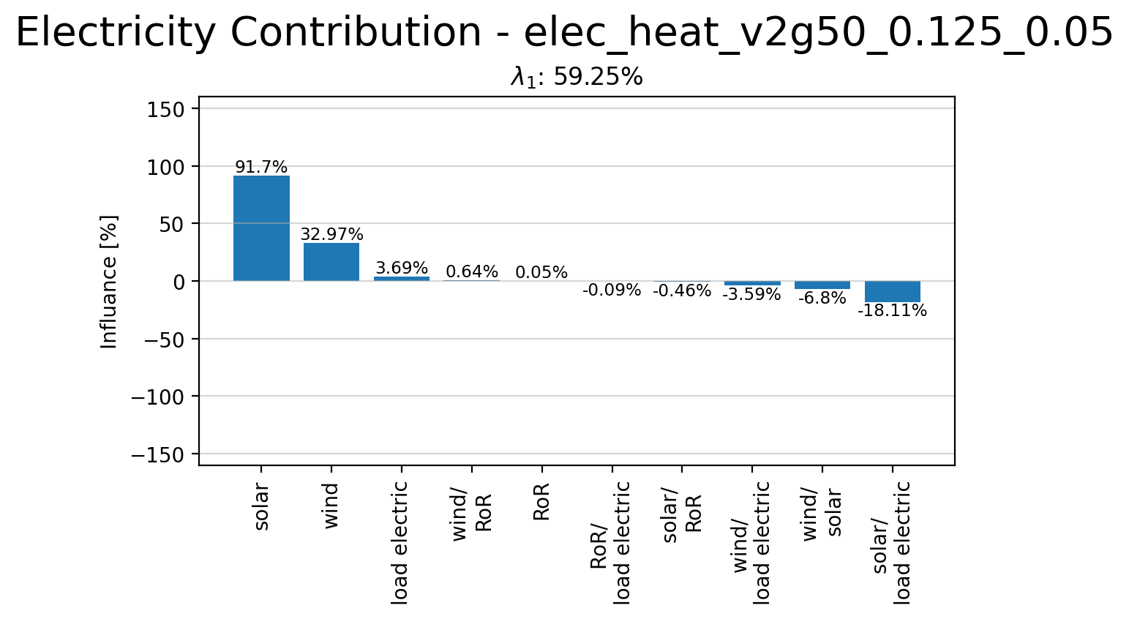
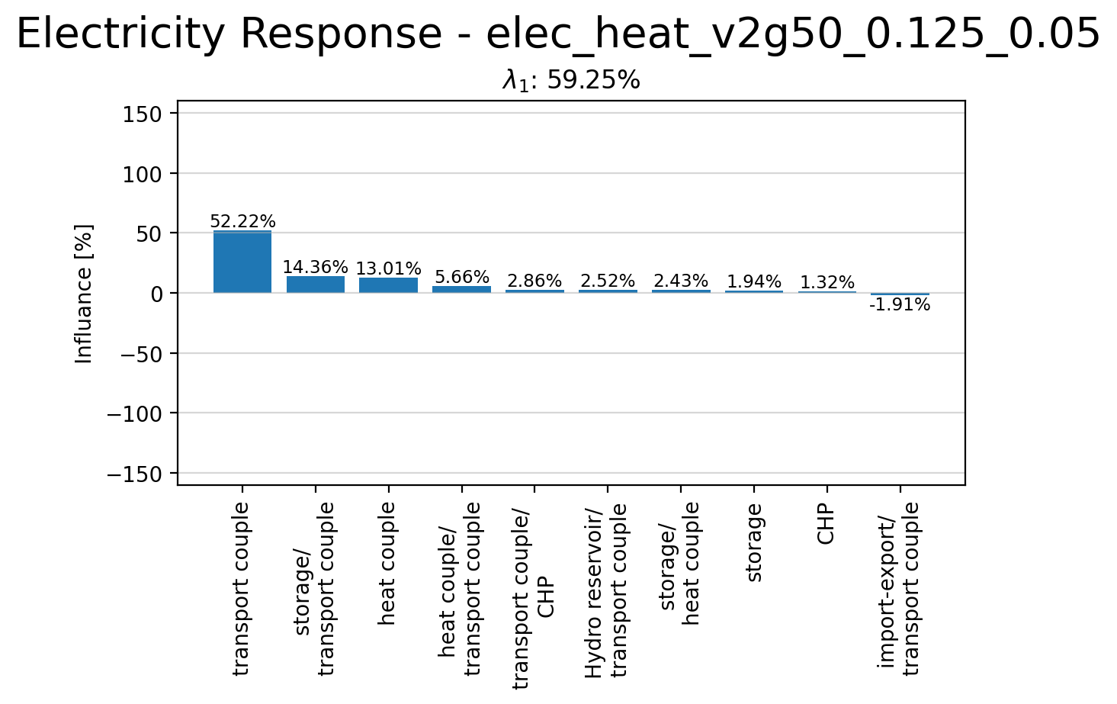
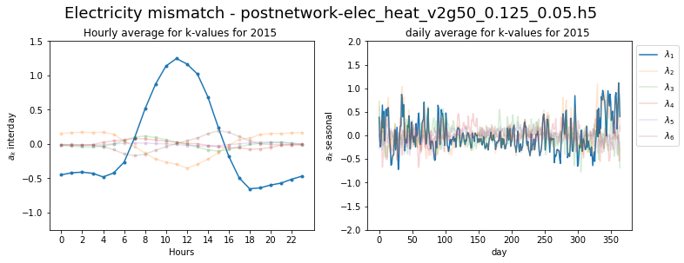
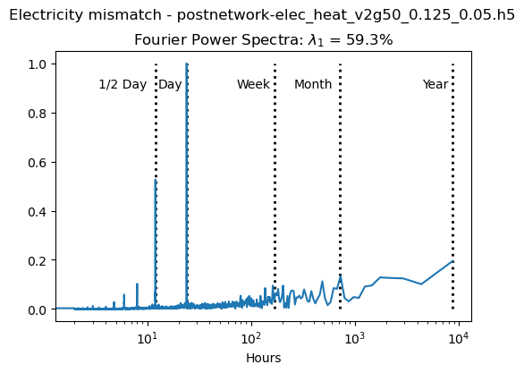
Principle Component 1

Slide 14
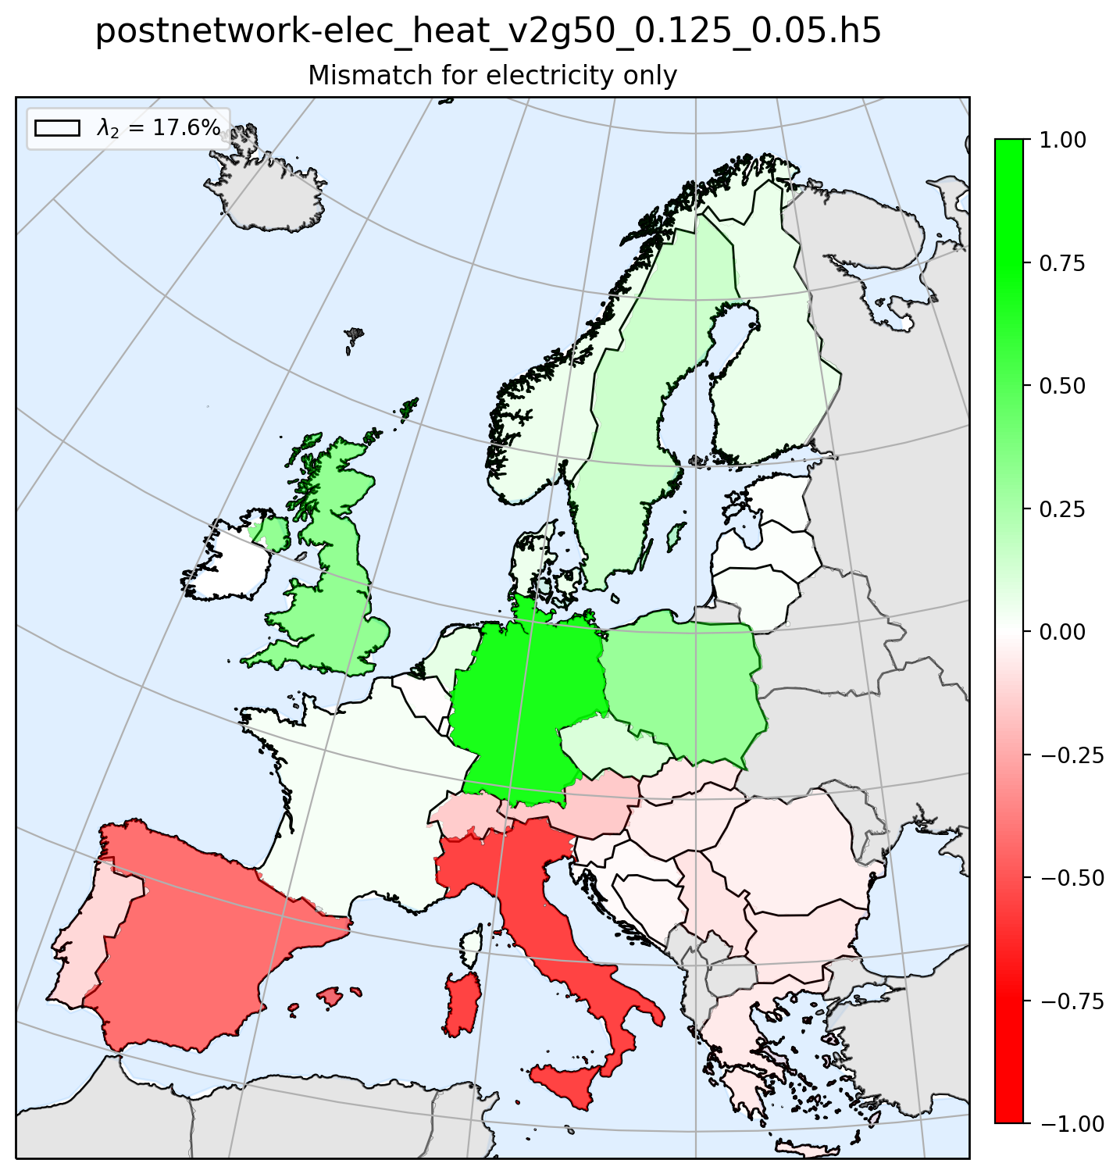
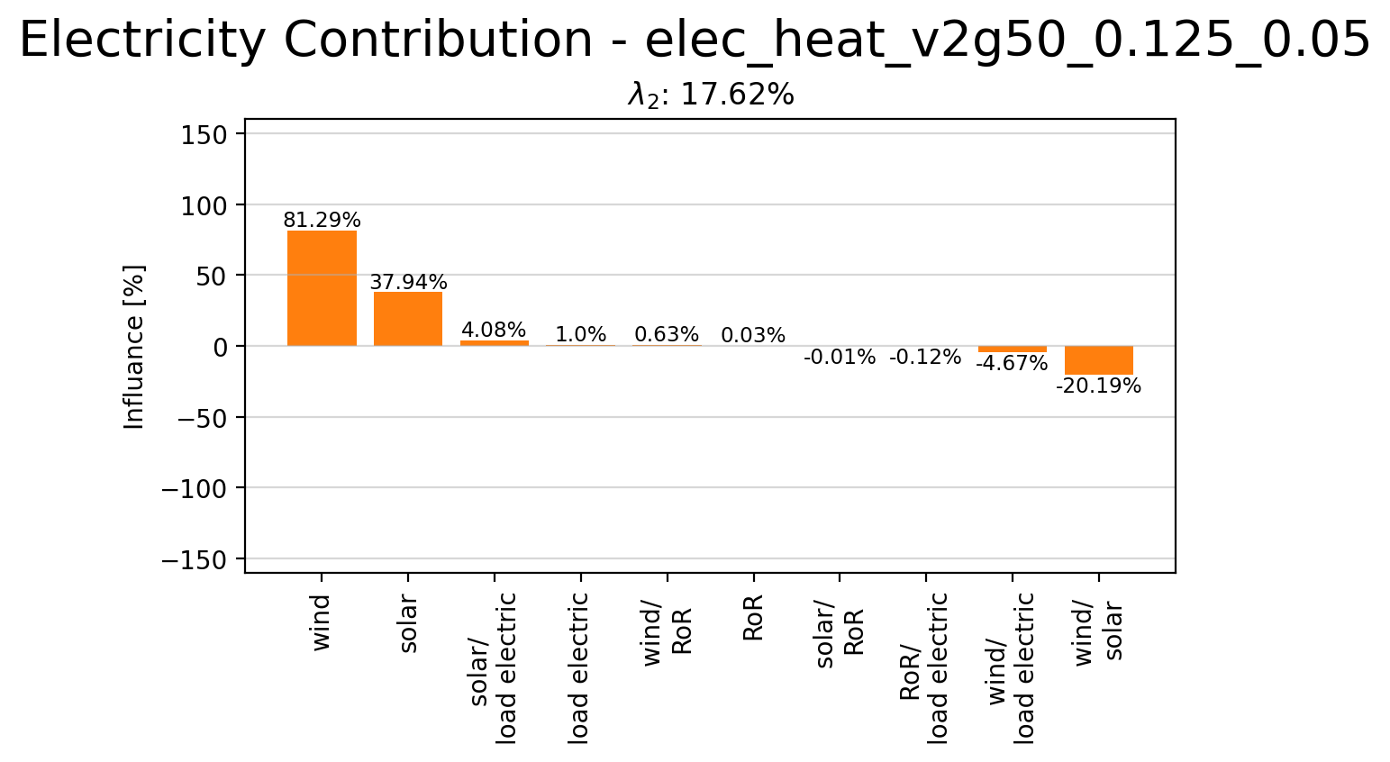
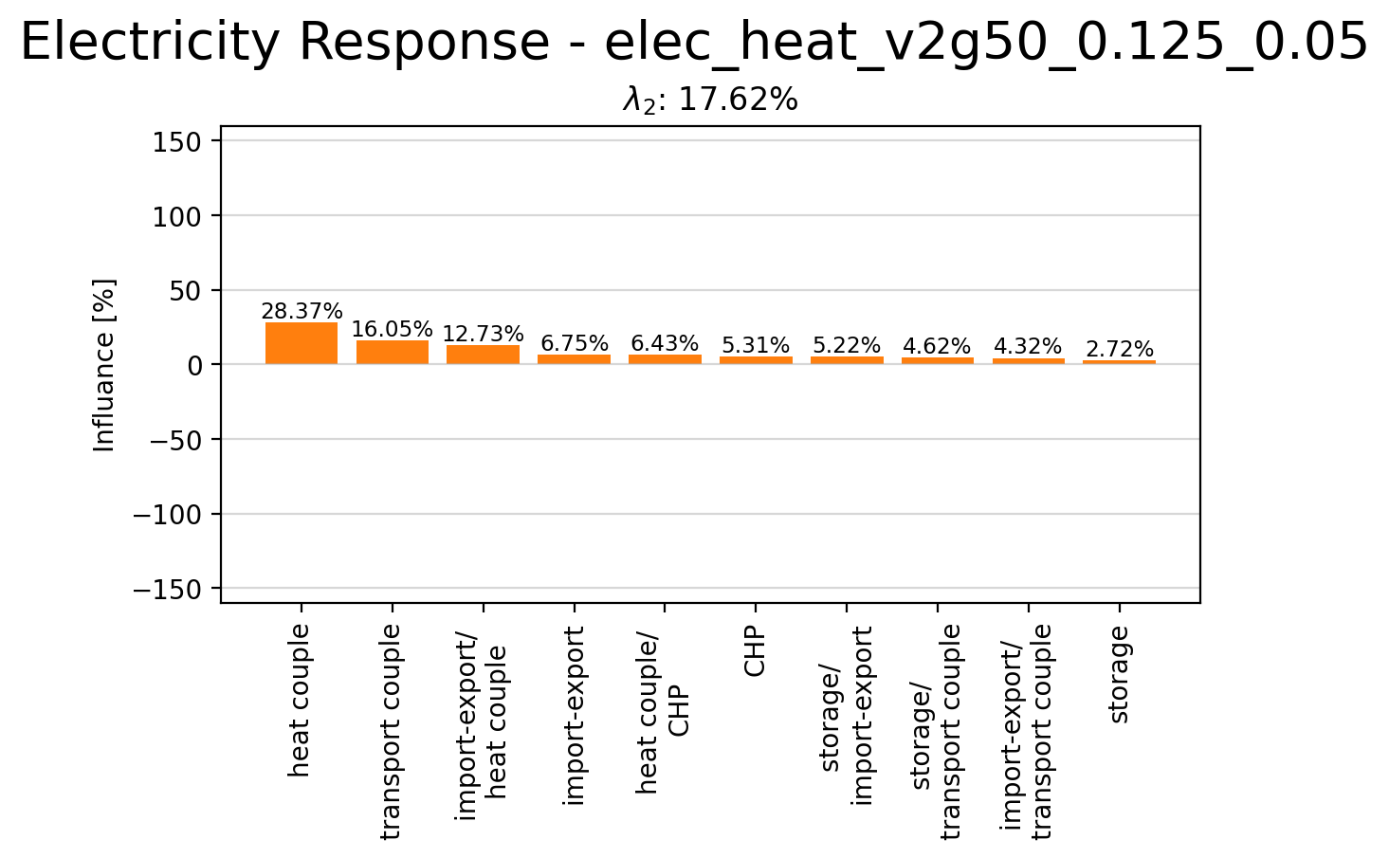
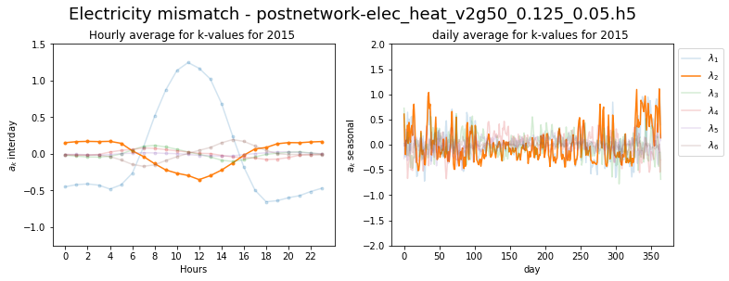
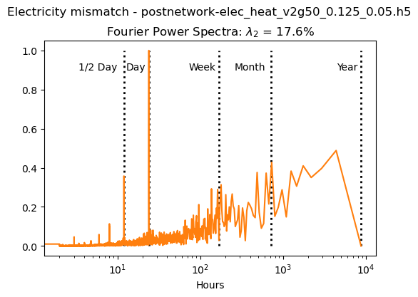
Principle Component 2

Slide 15
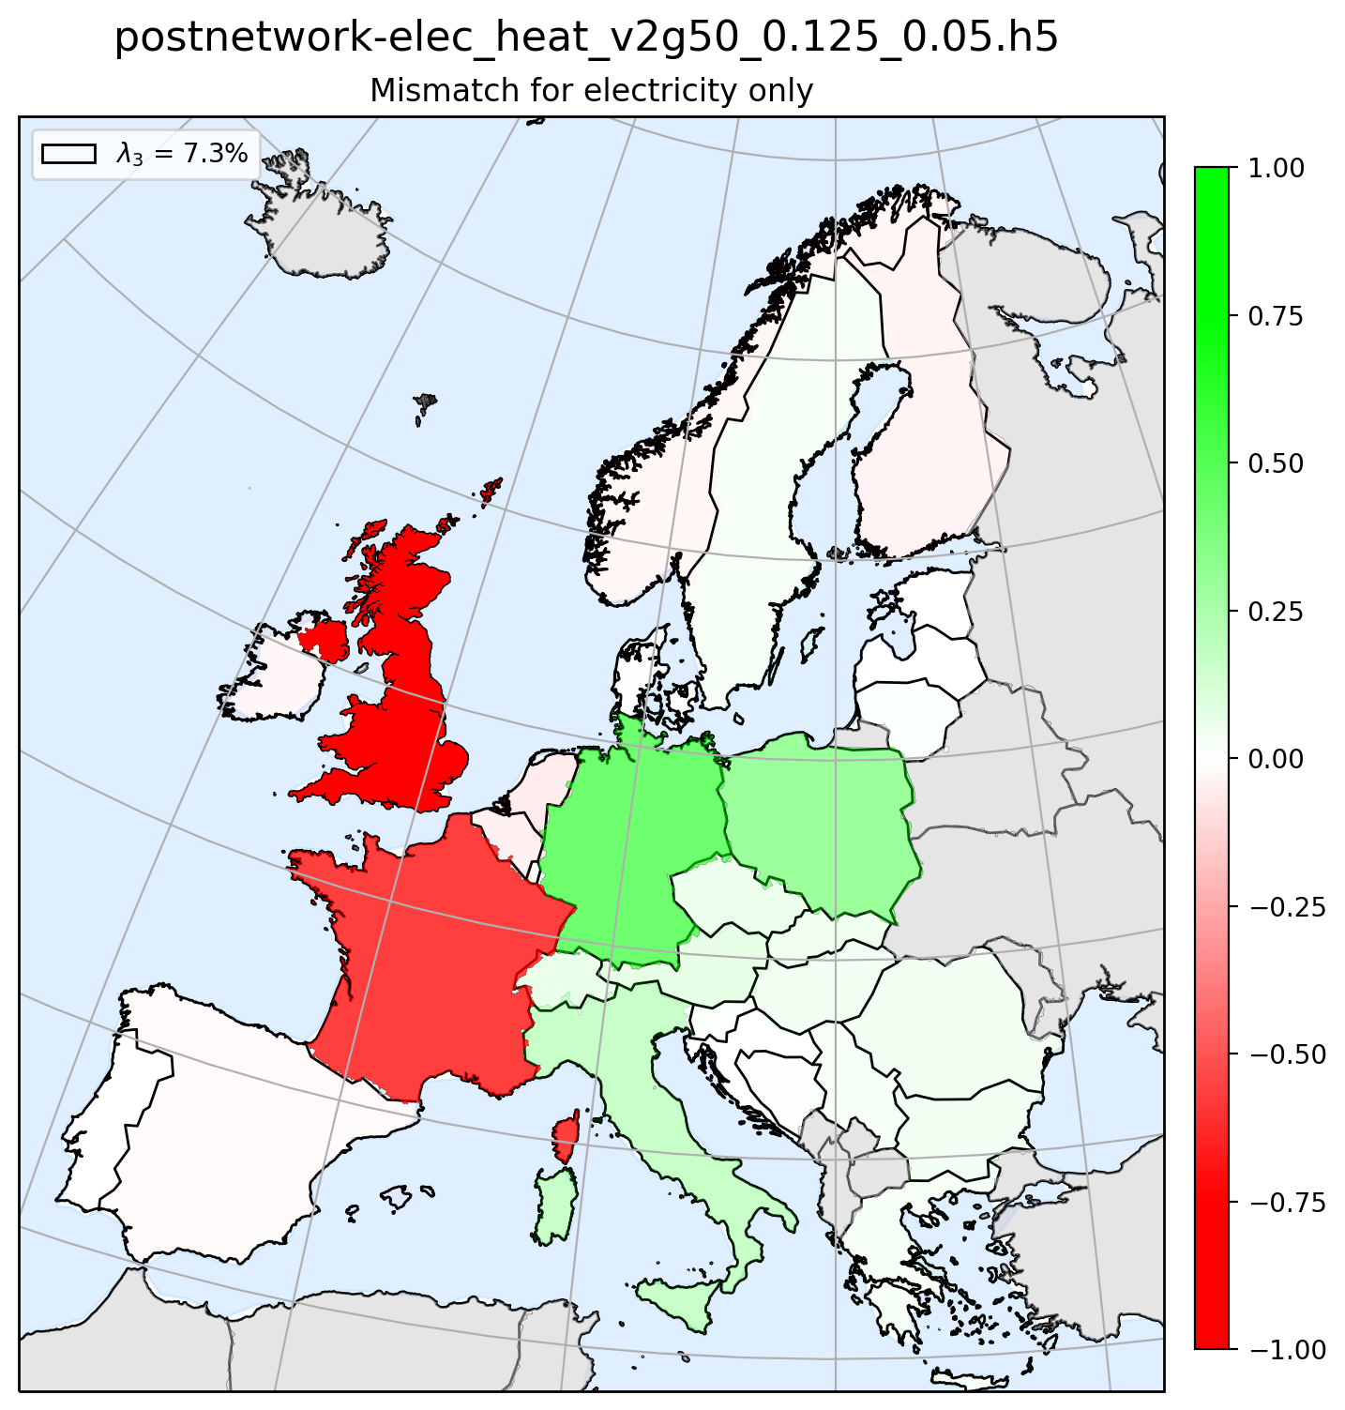
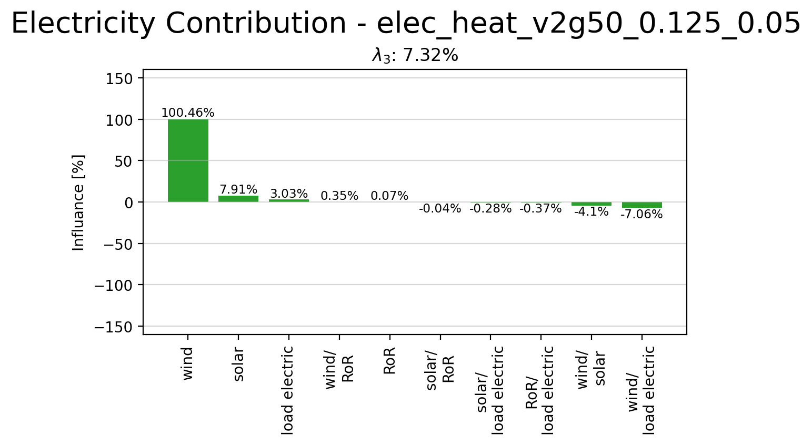
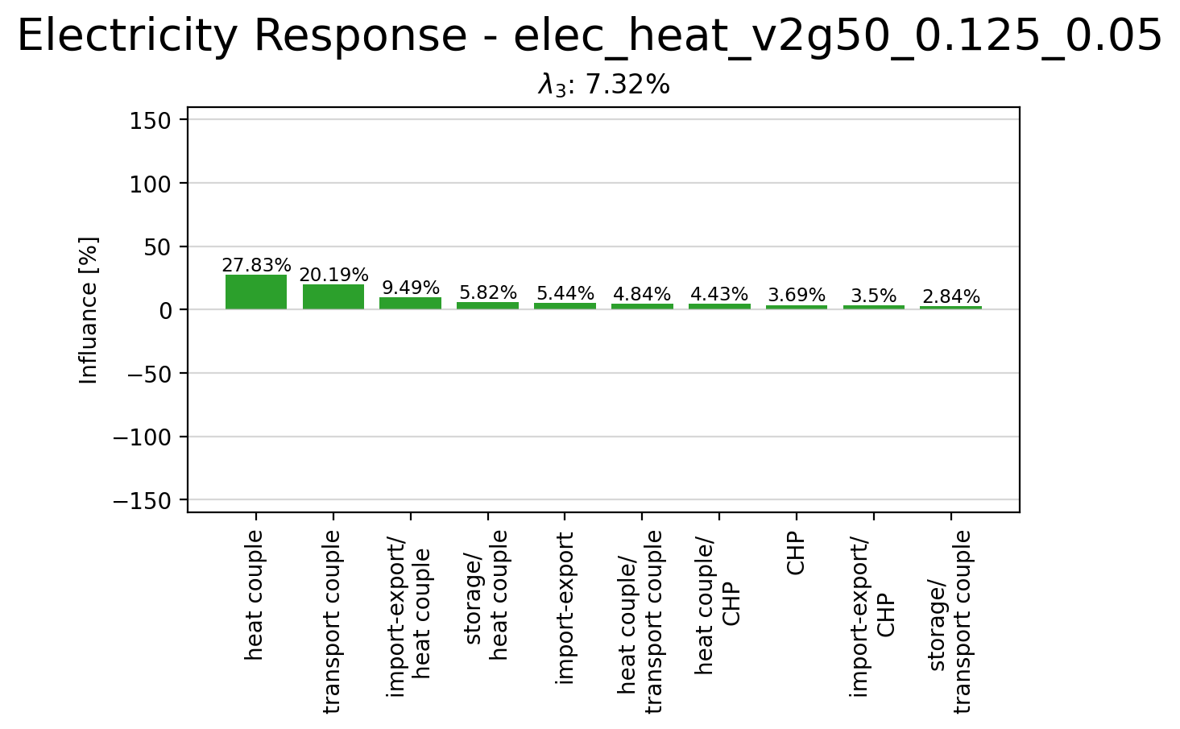
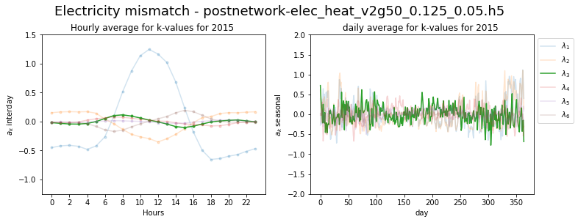
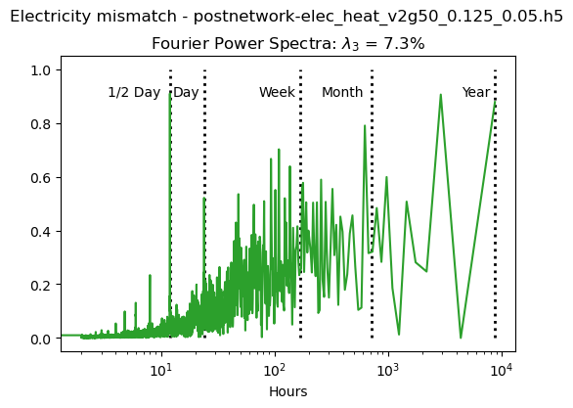
Principle Component 3

Slide 16
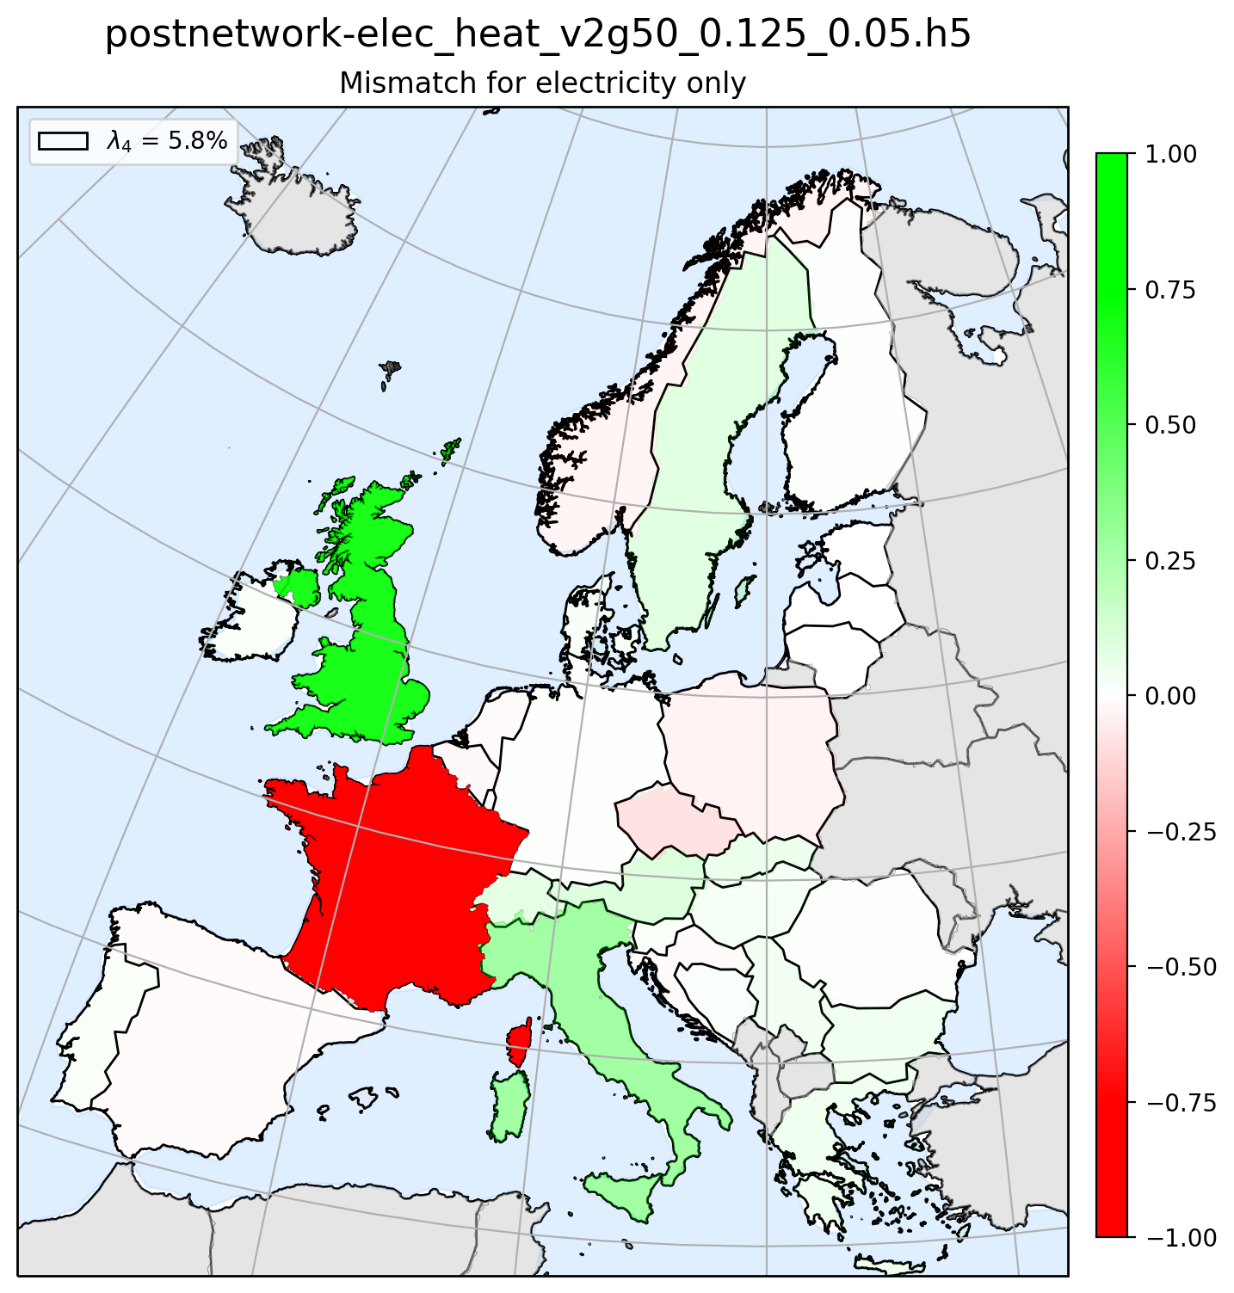
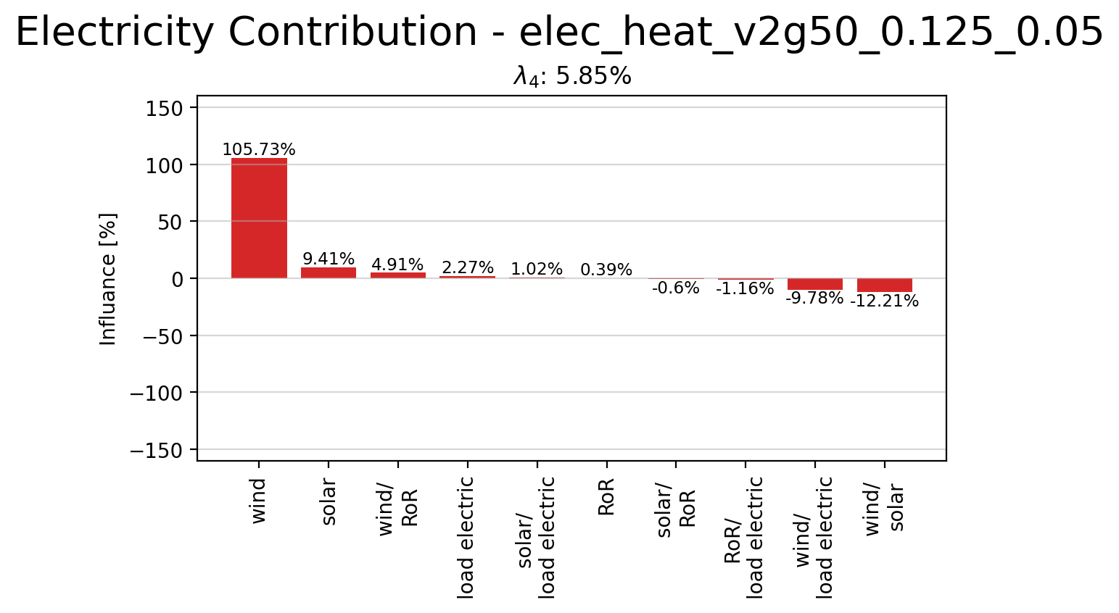
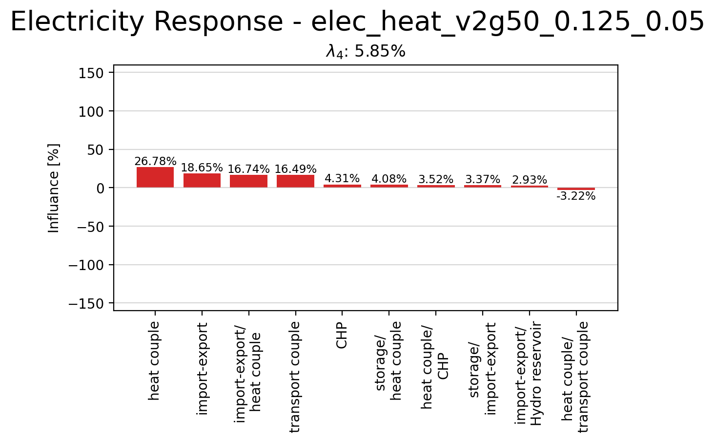
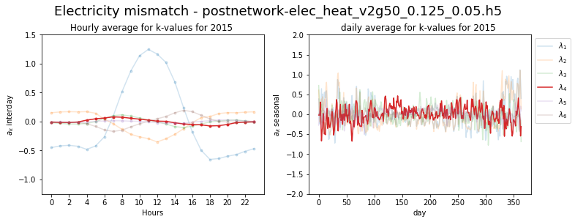
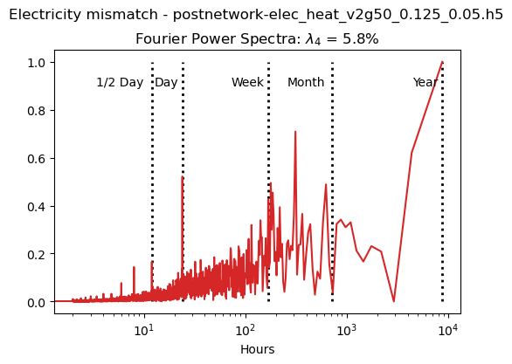
Principle Component 4

Slide 17
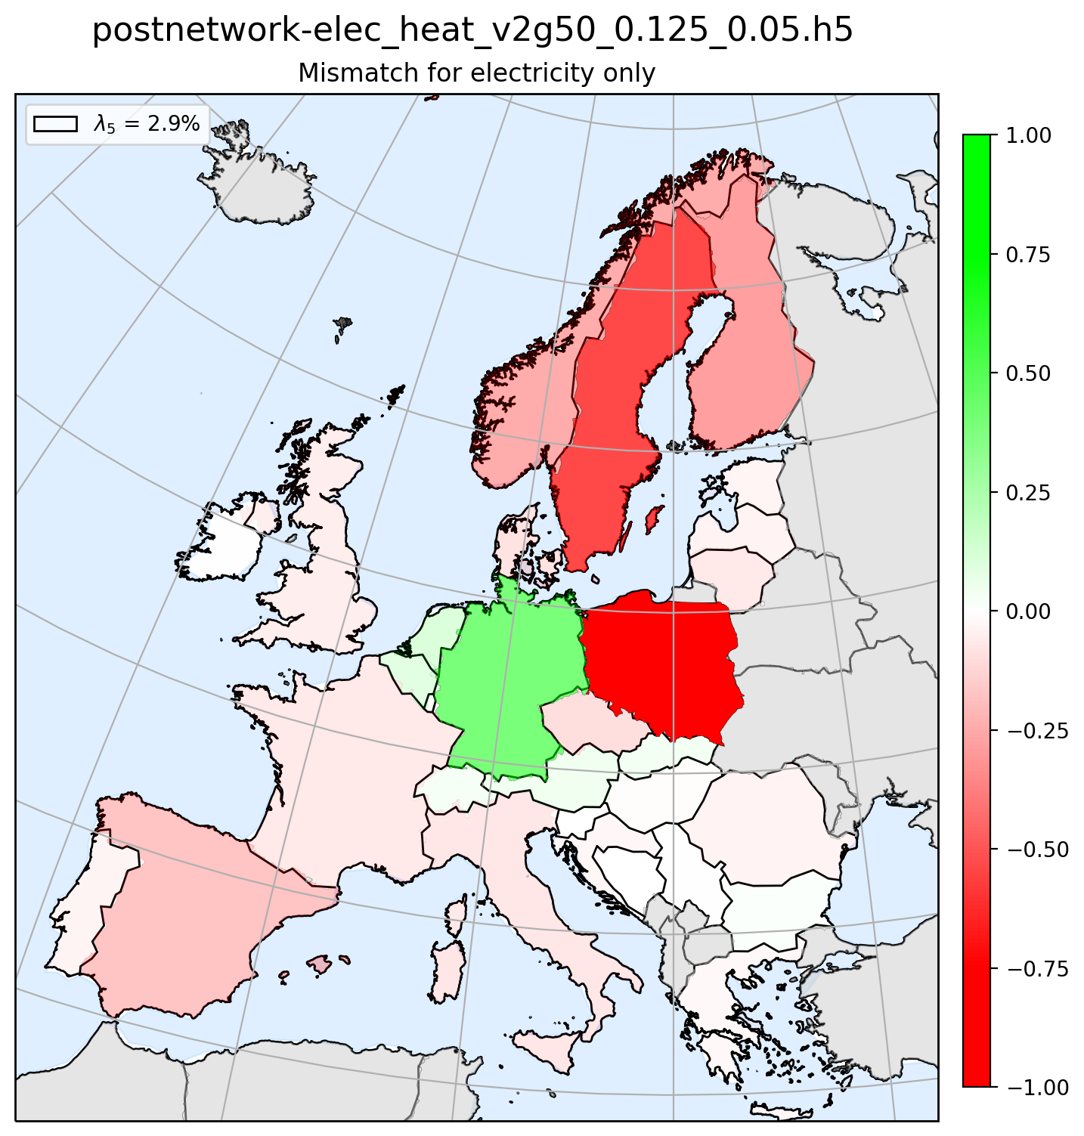
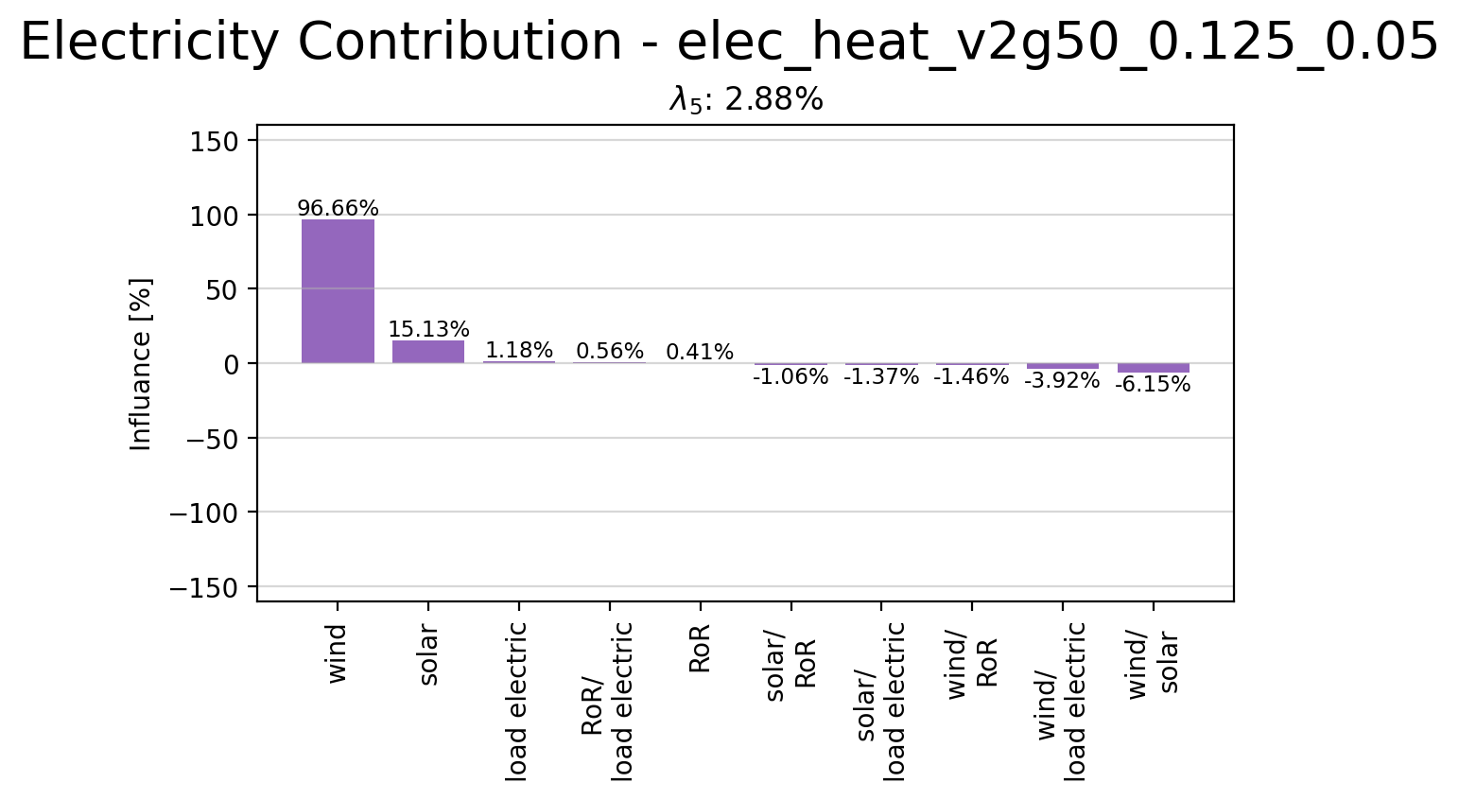
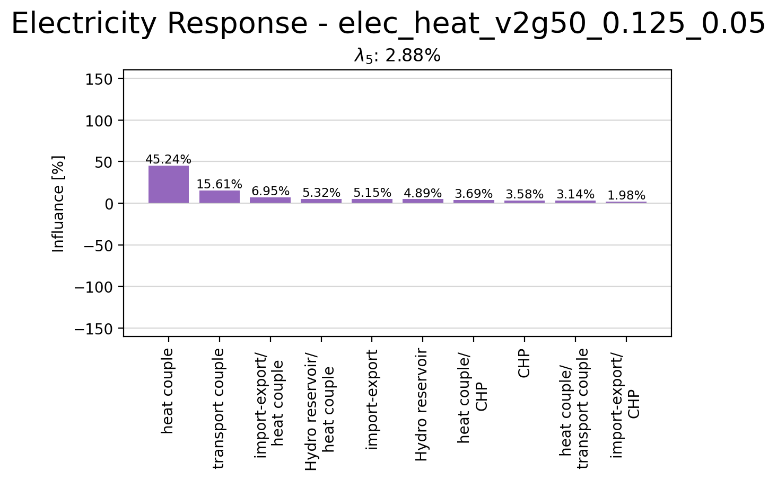
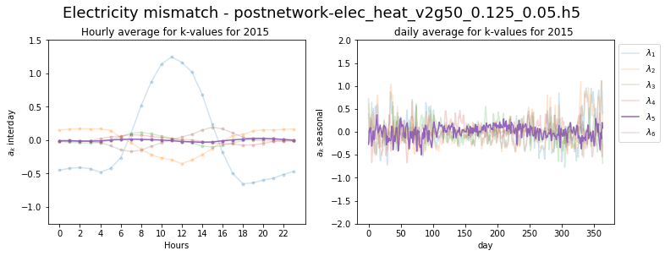
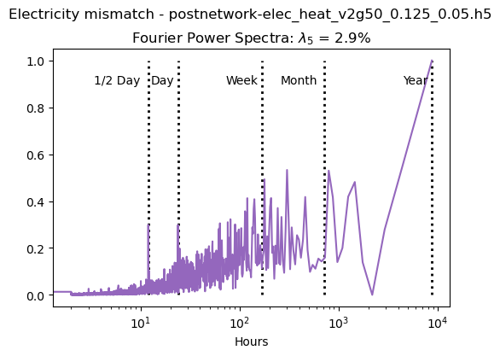
Principle Component 5

Slide 18
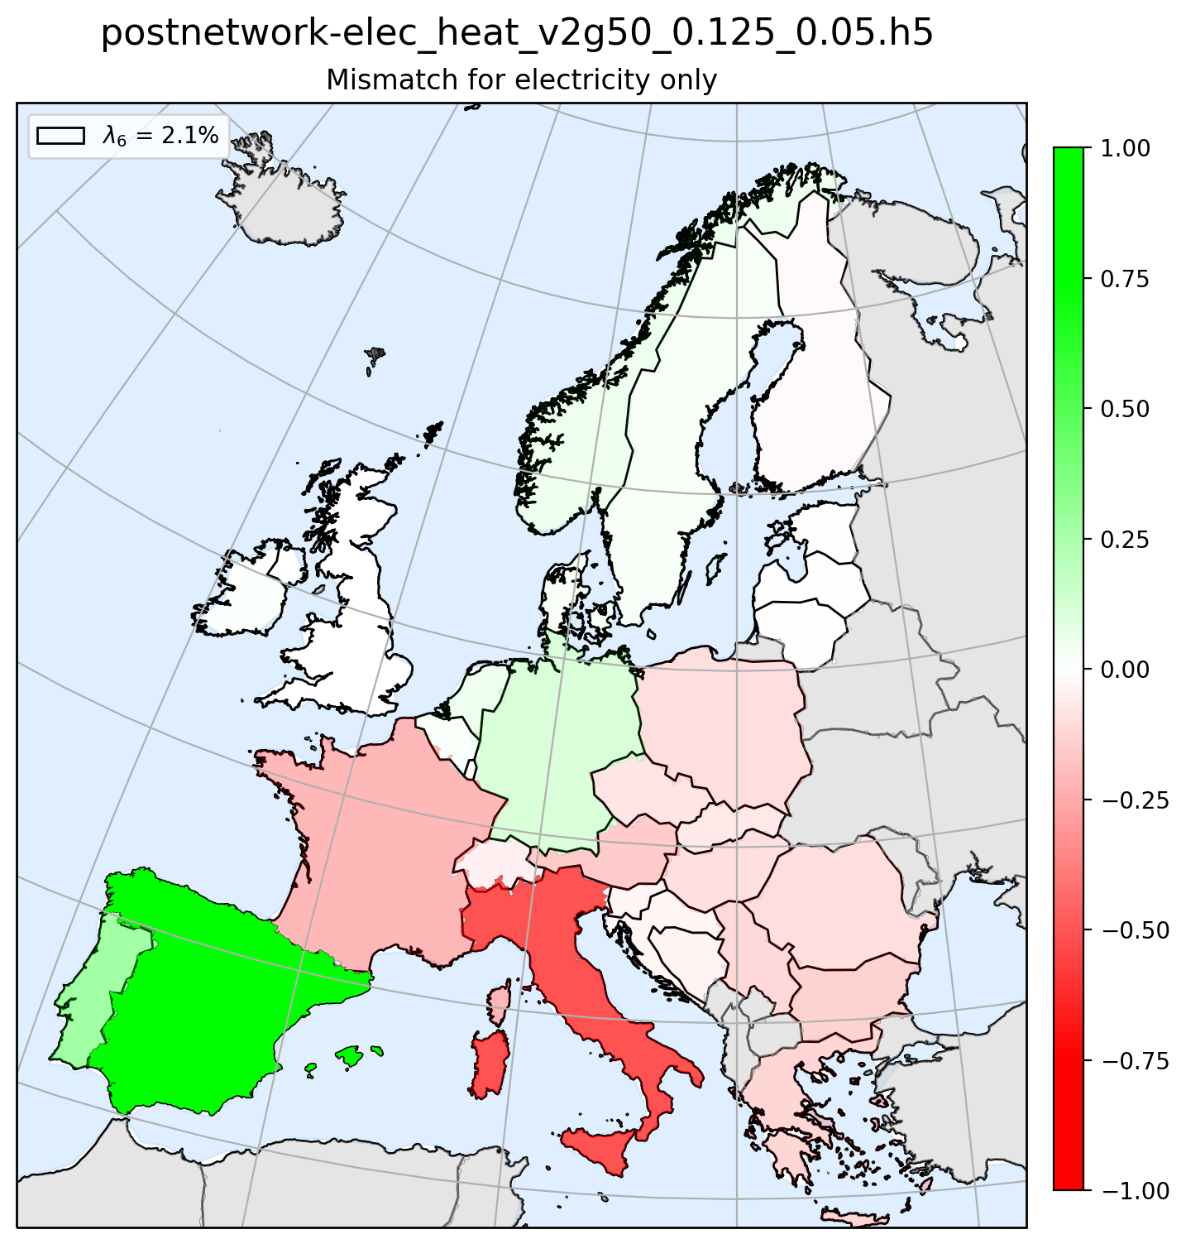
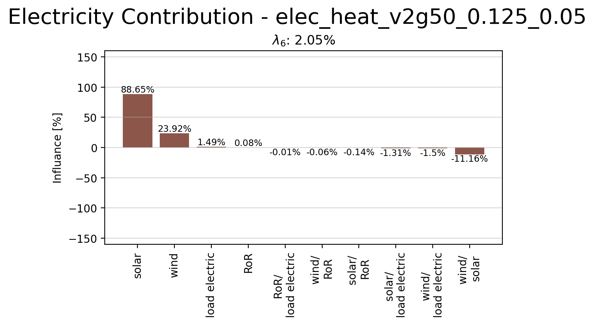
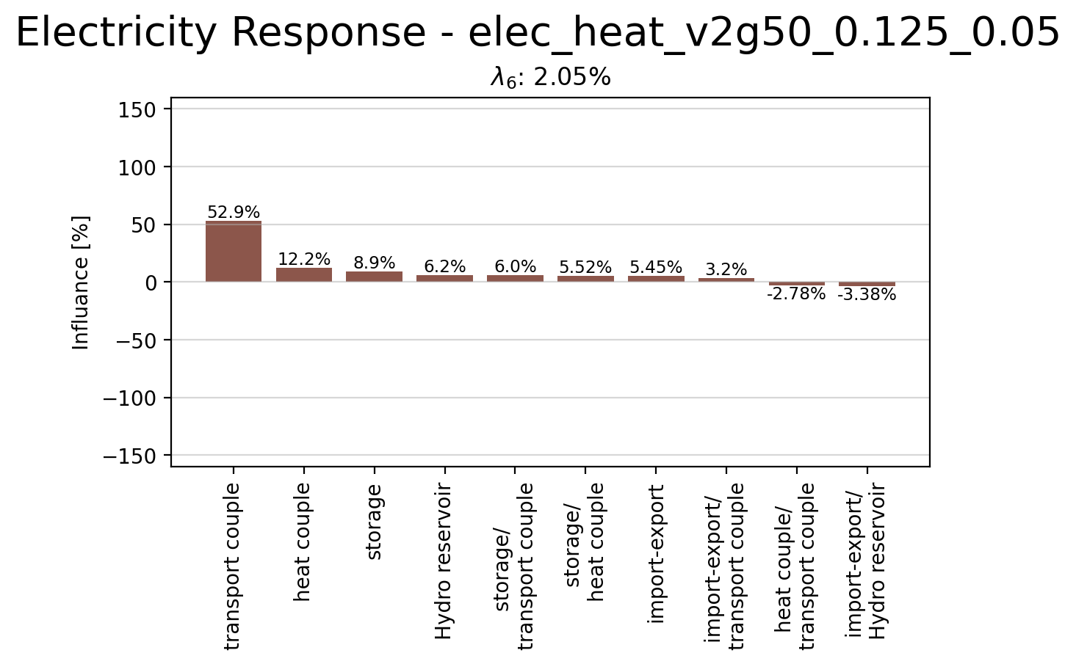
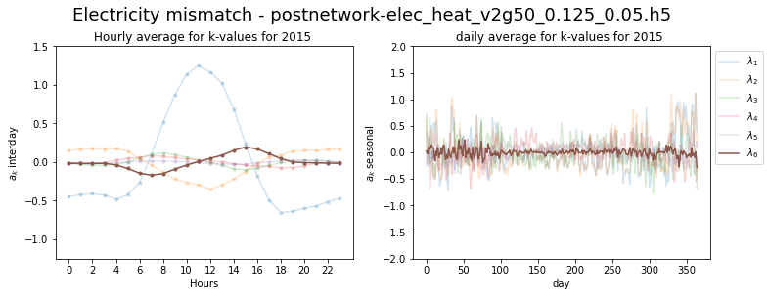
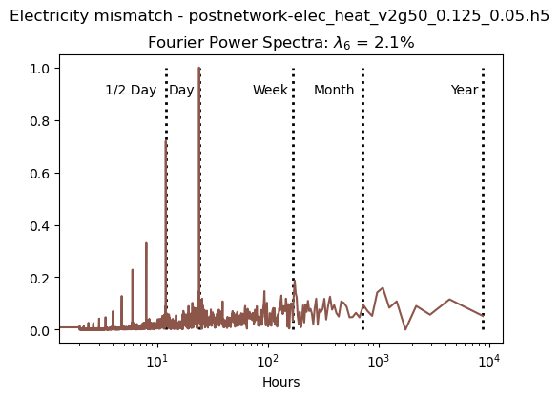
Principle Component 6

Slide 19
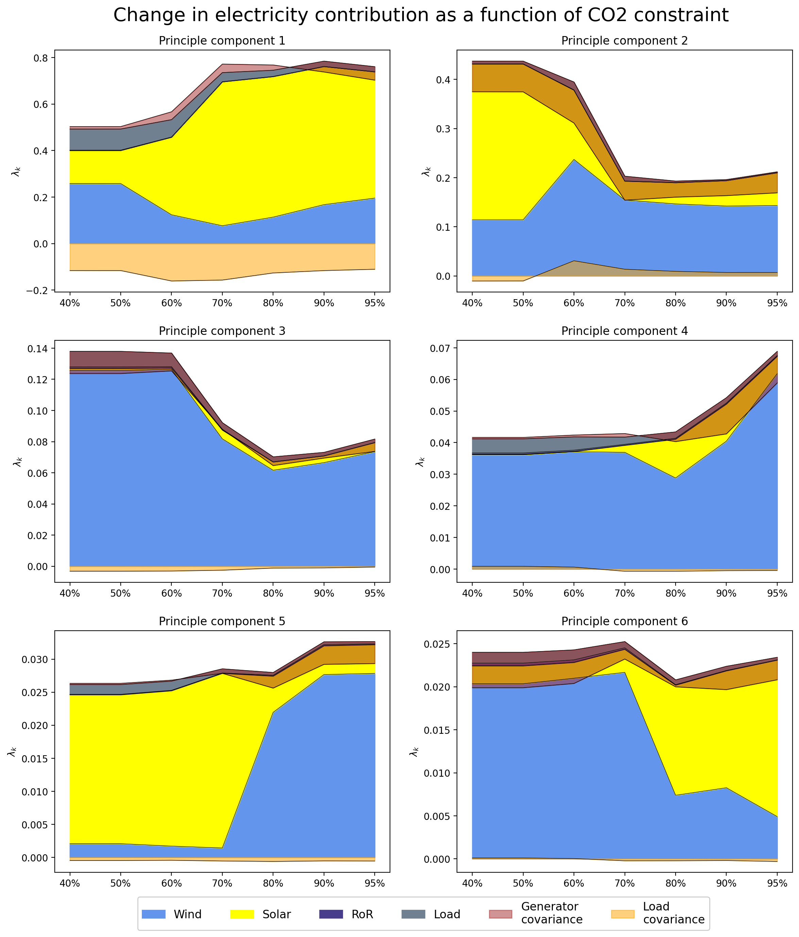
Change in Contribution due to CO2 Constrain

Slide 20
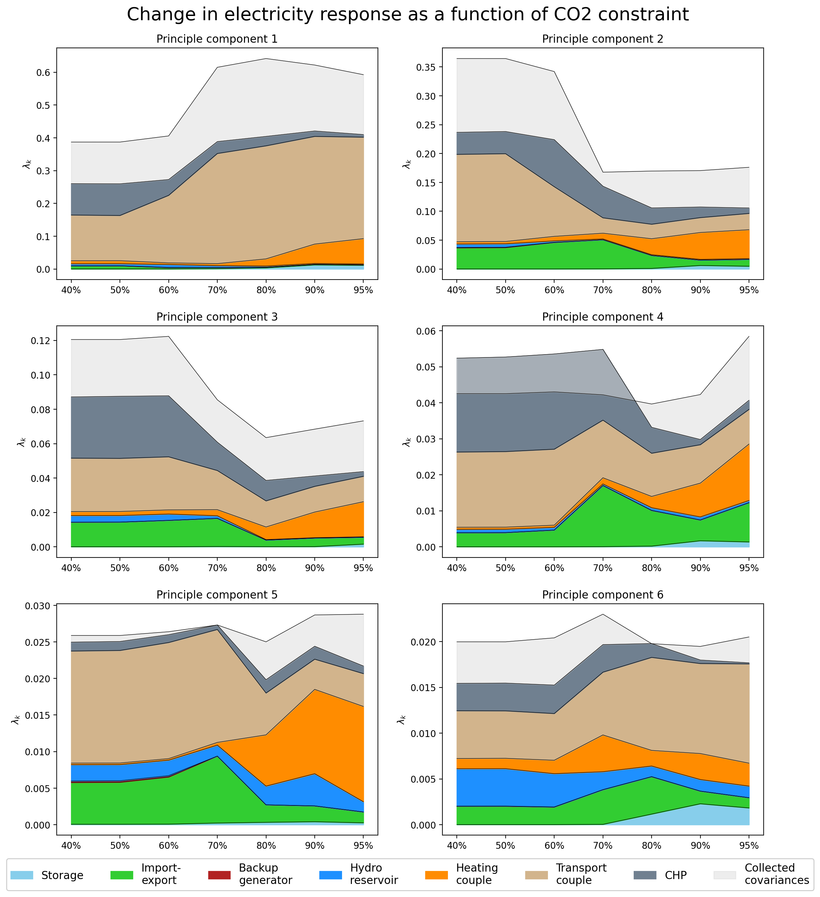
Change in Reponse due to CO2 Constrain

Slide 21
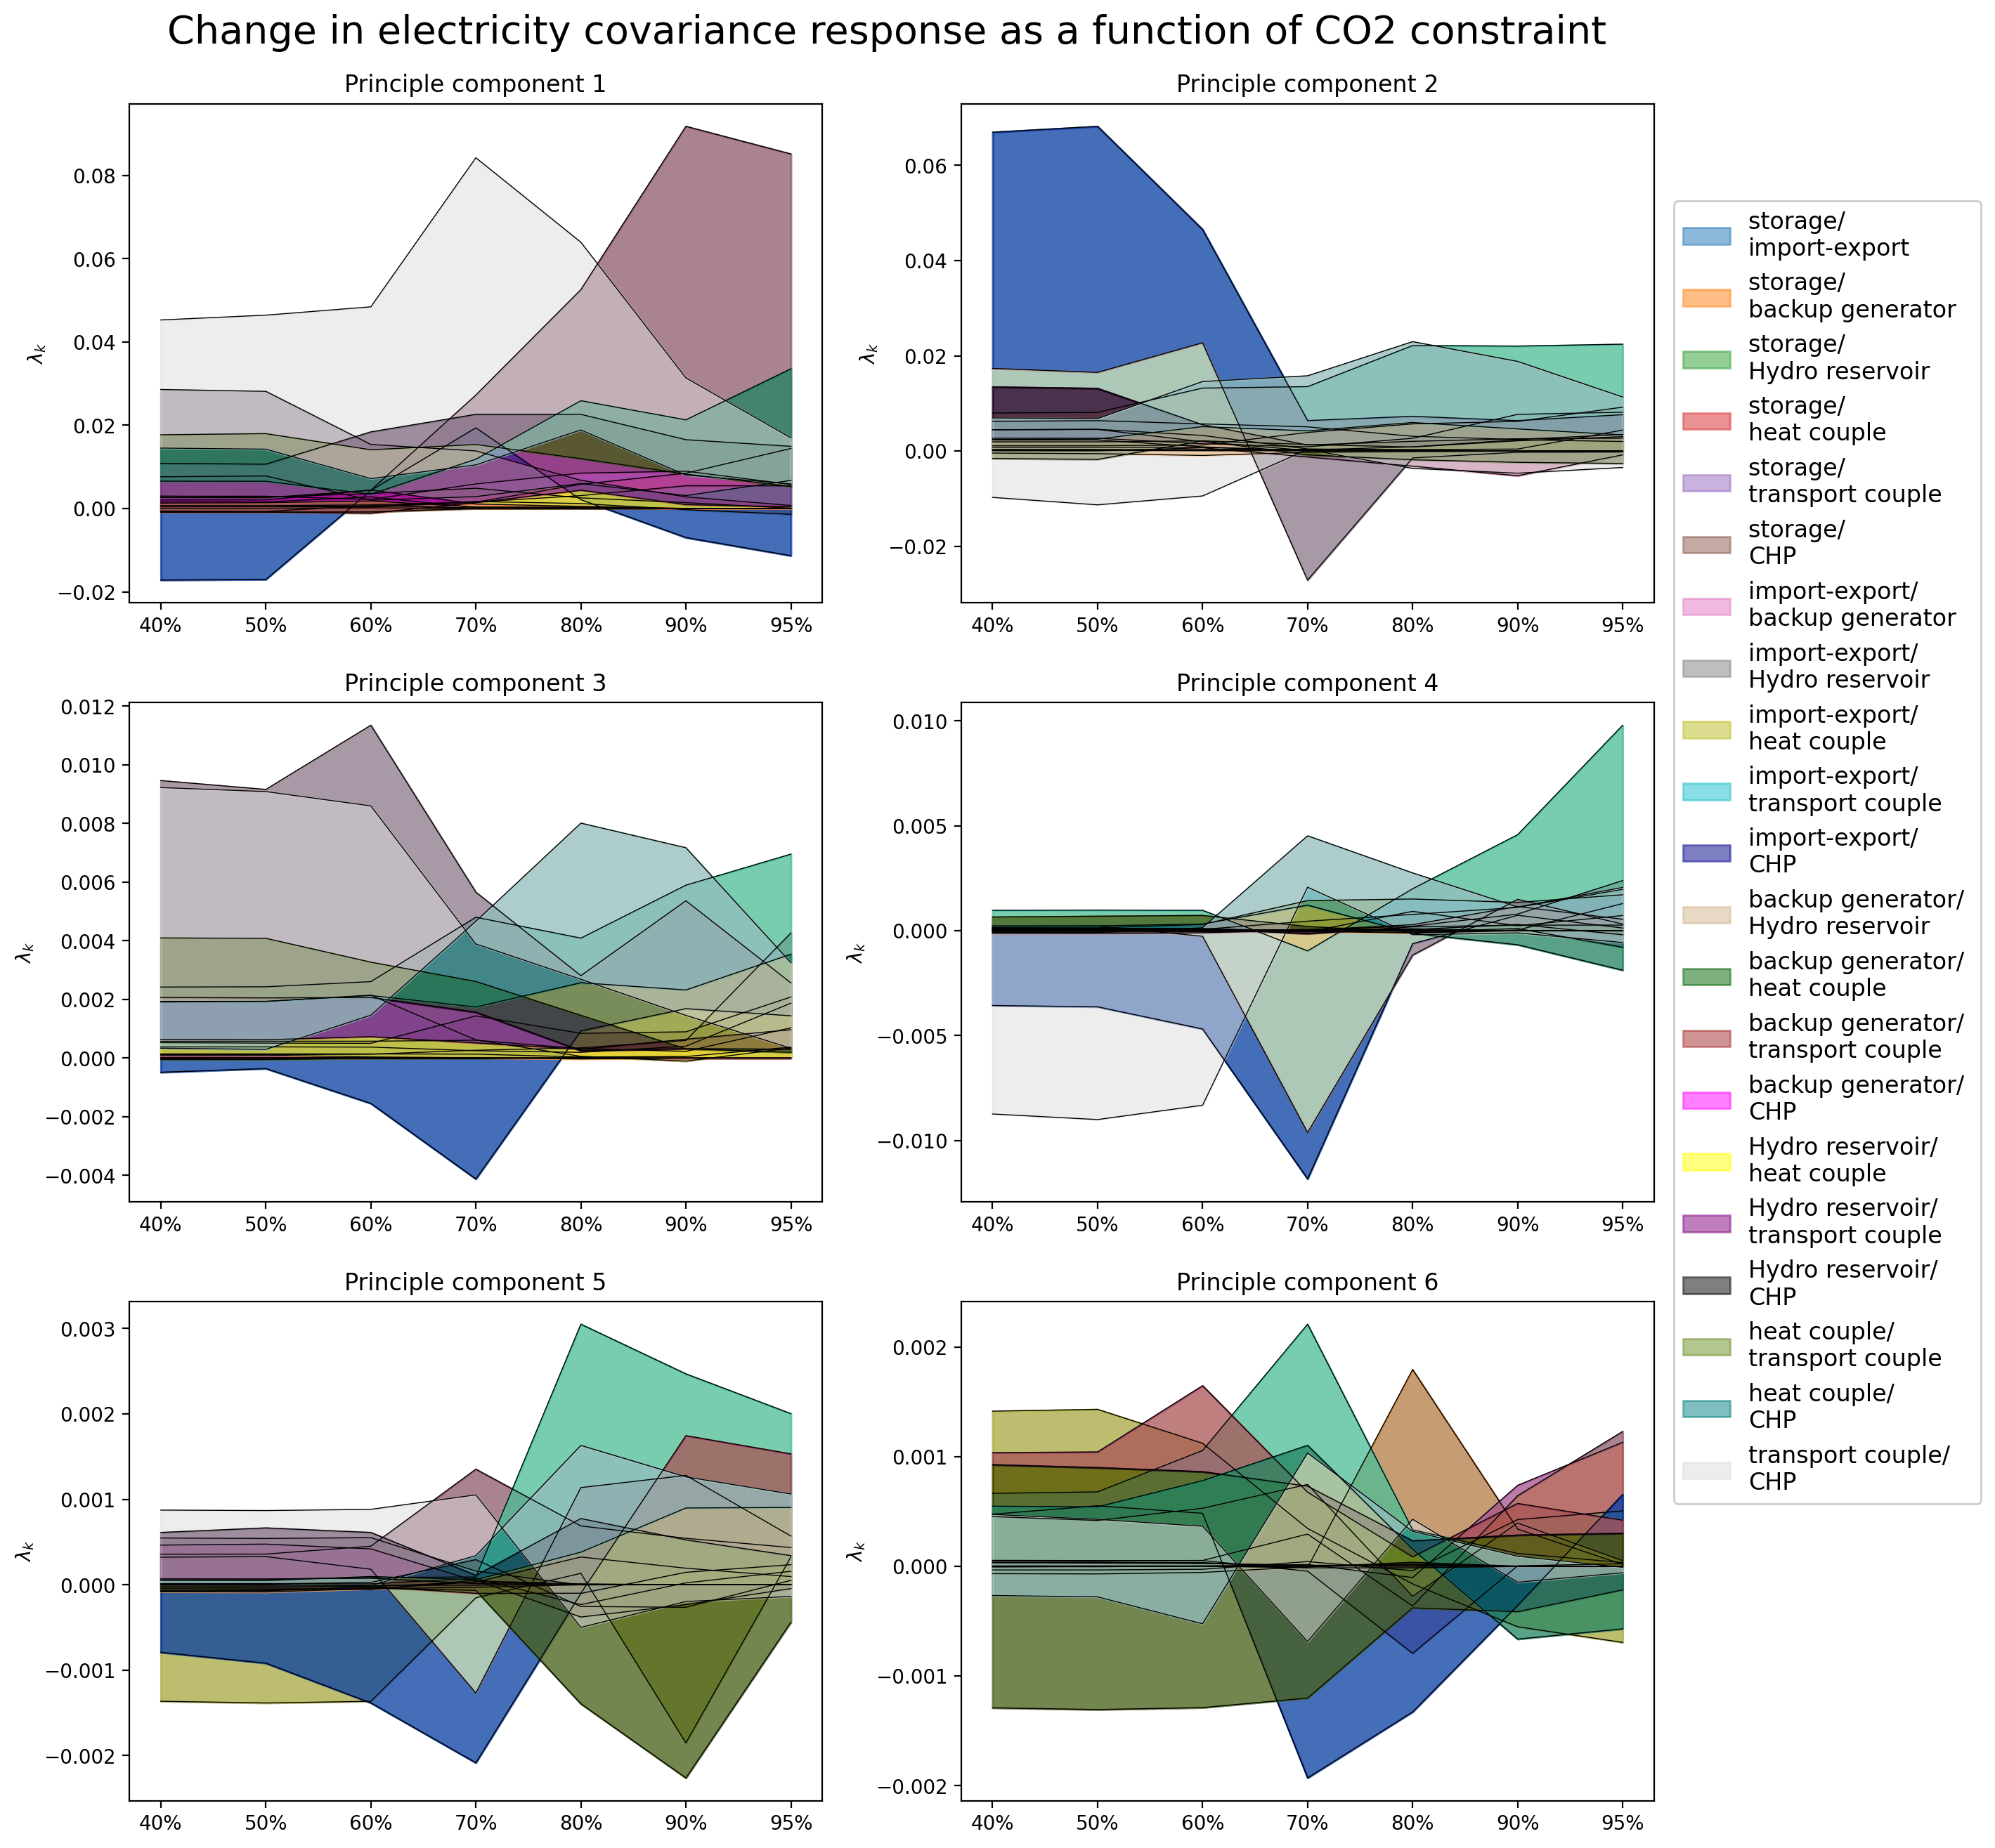
Change in Cov Reponse due to CO2 Constrain

Slide 22
Electricity Coupled with the Heating and Transport Sector
Electricity NP Analysis

Slide 23
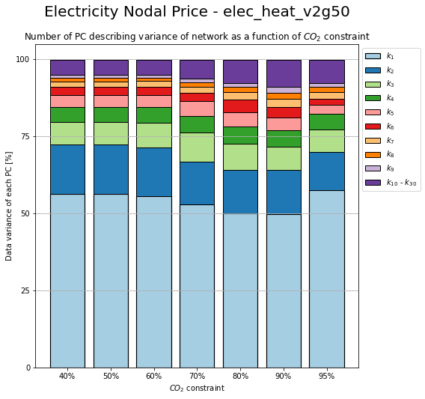
Change in PC due to CO2 Constrain

Slide 24
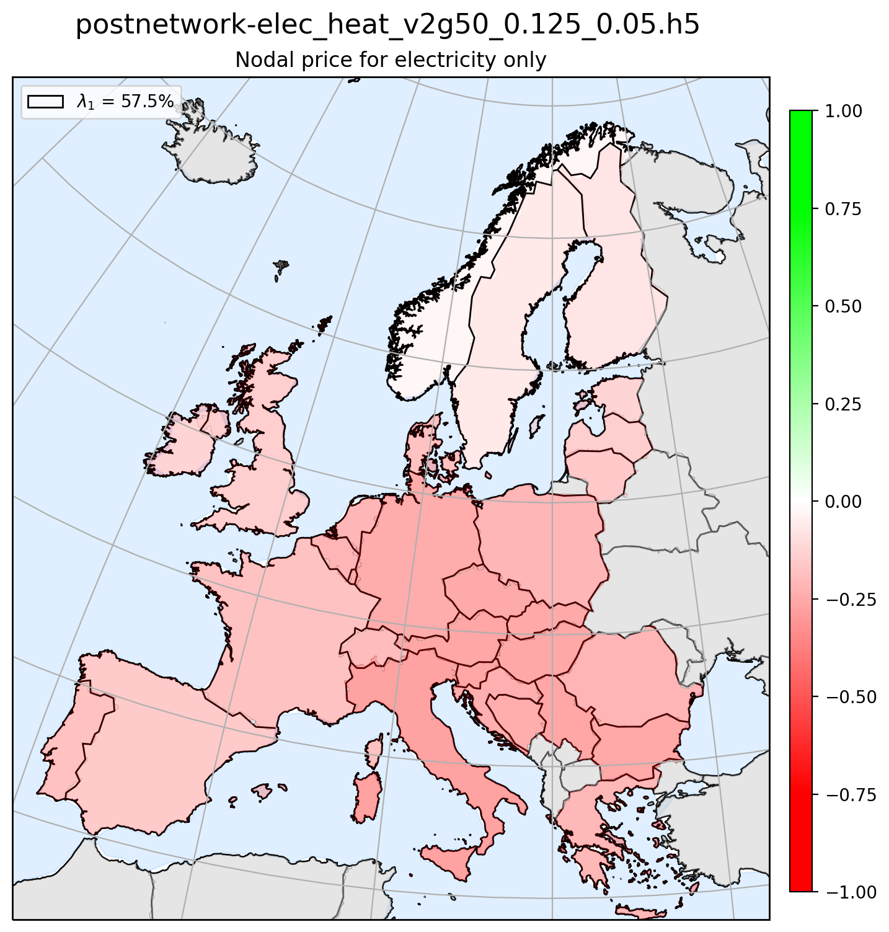
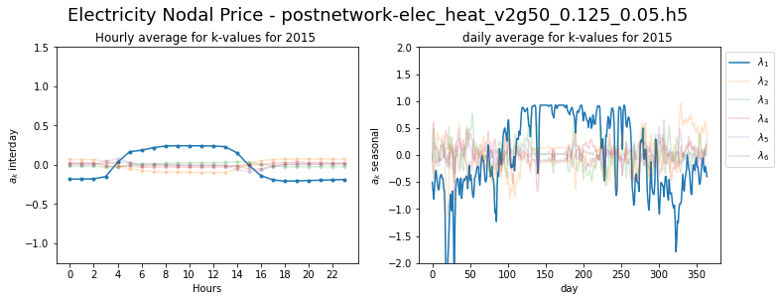
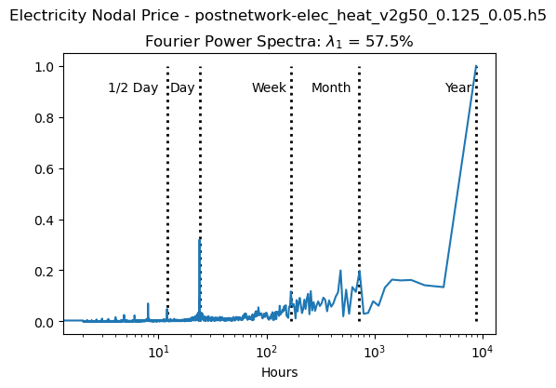
Principle Component 1

Slide 25
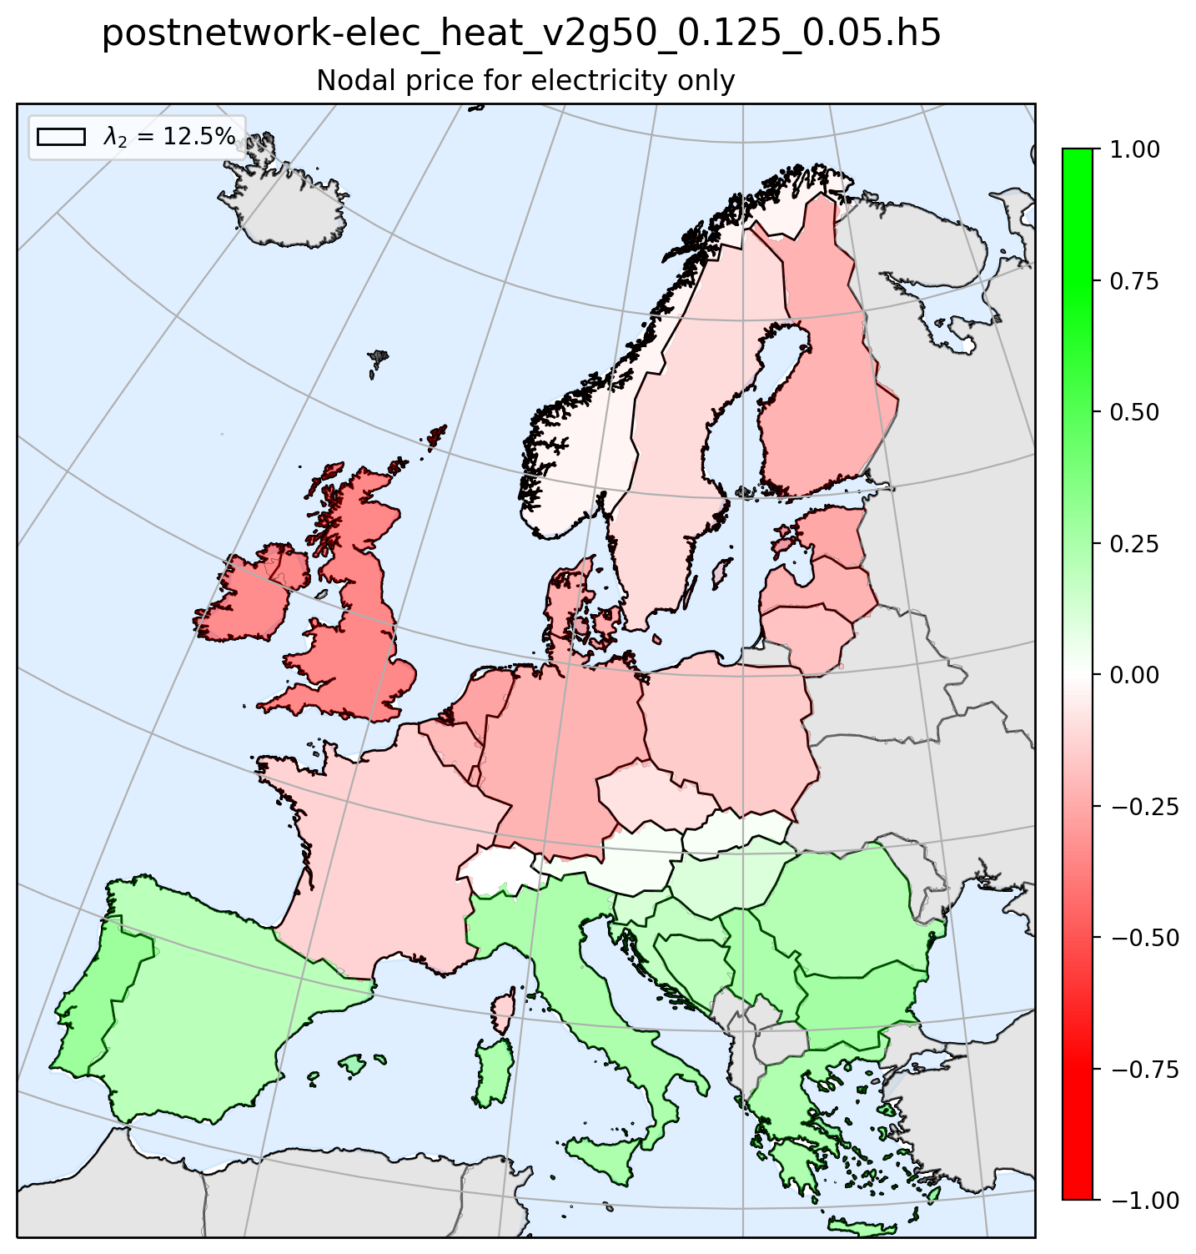
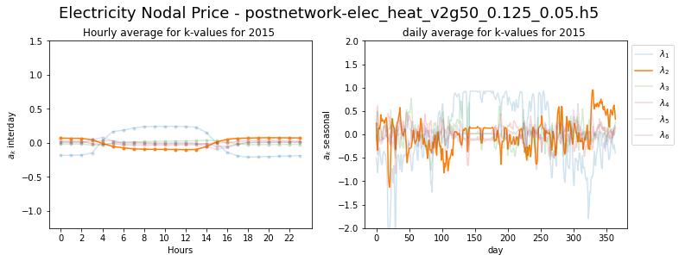

Principle Component 2

Slide 26



Principle Component 3

Slide 27



Principle Component 4

Slide 28



Principle Component 5

Slide 29



Principle Component 6

Slide 30
Electricity Coupled with the Heating and Transport Sector
Electricy Mismatch and NP Coherence

Slide 31

Coherence Method 1
Nodal Price
Mismatch
1)
2)
1)
2)
3)
4)
3)
4)
5)
6)
5)
6)

Slide 32

Coherence Method 2
Nodal Price
Mismatch
1)
2)
1)
2)
3)
4)
3)
4)
5)
6)
5)
6)

Slide 33

Coherence Method 3
Nodal Price
Mismatch
1)
2)
1)
2)
3)
4)
3)
4)
5)
6)
5)
6)

Slide 34
Electricity Coupled with the Heating and Transport Sector
Heating Mismatch Analysis

Slide 35

Installed capacity

Slide 36

Heating Supplied by Different Technologies

Slide 37

Installed storage (energy capacity)

Slide 38

Installed storage (power capacity)

Slide 39

Change in PC due to CO2 and Transmission Constrain

Slide 40





Principle Component 1

Slide 41





Principle Component 2

Slide 42





Principle Component 3

Slide 43





Principle Component 4

Slide 44





Principle Component 5

Slide 45





Principle Component 6

Slide 46

Change in Contribution due to CO2 and Transmission Constrain

Slide 47

Change in Reponse due to CO2 and Transmission Constrain

Slide 48

Change in Cov Reponse due to CO2 and Transmission Constrain

Slide 49
Electricity Coupled with the Heating and Transport Sector
Heating NP Analysis

Slide 50

Change in PC due to CO2 and Transmission Constrain

Slide 51



Principle Component 1

Slide 52



Principle Component 2

Slide 53



Principle Component 3

Slide 54



Principle Component 4

Slide 55



Principle Component 5

Slide 56



Principle Component 6

Slide 57
Electricity Coupled with the Heating and Transport Sector
Heating Mismatch and NP Coherence

Slide 58

Coherence Method 1
Nodal Price
Mismatch
1)
2)
1)
2)
3)
4)
3)
4)
5)
6)
5)
6)

Slide 59

Coherence Method 2
Nodal Price
Mismatch
1)
2)
1)
2)
3)
4)
3)
4)
5)
6)
5)
6)

Slide 60

Coherence Method 3
Nodal Price
Mismatch
1)
2)
1)
2)
3)
4)
3)
4)
5)
6)
5)
6)

Slide 61
Electricity Coupled with the Heating and Transport Sector
Transport Mismatch Analysis

Slide 62

Change in PC due to CO2 Constrain

Slide 63



Principle Component 1

Slide 64



Principle Component 2

Slide 65



Principle Component 3

Slide 66



Principle Component 4

Slide 67



Principle Component 5

Slide 68



Principle Component 6

Slide 69
Electricity Coupled with the Heating and Transport Sector
Transport NP Analysis

Slide 70

Change in PC due to CO2 Constrain

Slide 71



Principle Component 1

Slide 72



Principle Component 2

Slide 73



Principle Component 3

Slide 74



Principle Component 4

Slide 75



Principle Component 5

Slide 76



Principle Component 6

Slide 77
Electricity Coupled with the Heating and Transport Sector
Transport Mismatch and NP Coherence

Slide 78

Coherence Method 1
Nodal Price
Mismatch
1)
2)
1)
2)
3)
4)
3)
4)
5)
6)
5)
6)

Slide 79

Coherence Method 2
Nodal Price
Mismatch
1)
2)
1)
2)
3)
4)
3)
4)
5)
6)
5)
6)

Slide 80

Coherence Method 3
Nodal Price
Mismatch
1)
2)
1)
2)
3)
4)
3)
4)
5)
6)
5)
6)

Slide 81
Electricity Coupled with the Heating and Transport Sector
Electricity NP and Heating NP Coherence

Slide 82

Coherence Method 1
HNP
ENP
1)
2)
1)
2)
3)
4)
3)
4)
5)
6)
5)
6)

Slide 83

Coherence Method 2
HNP
ENP
1)
2)
1)
2)
3)
4)
3)
4)
5)
6)
5)
6)

Slide 84

Coherence Method 3
HNP
ENP
1)
2)
1)
2)
3)
4)
3)
4)
5)
6)
5)
6)

Slide 85
Electricity Coupled with the Heating and Transport Sector
Electricity NP and Transport NP Coherence

Slide 86

Coherence Method 1
TNP
ENP
1)
2)
1)
2)
3)
4)
3)
4)
5)
6)
5)
6)

Slide 87

Coherence Method 2
TNP
ENP
1)
2)
1)
2)
3)
4)
3)
4)
5)
6)
5)
6)

Slide 88

Coherence Method 3
TNP
ENP
1)
2)
1)
2)
3)
4)
3)
4)
5)
6)
5)
6)

Slide 89
Electricity Coupled with the Heating and Transport Sector
Heating NP and Transport NP Coherence

Slide 90

Coherence Method 1
TNP
HNP
1)
2)
1)
2)
3)
4)
3)
4)
5)
6)
5)
6)

Slide 91

Coherence Method 2
TNP
HNP
1)
2)
1)
2)
3)
4)
3)
4)
5)
6)
5)
6)

Slide 92

Coherence Method 3
TNP
HNP
1)
2)
1)
2)
3)
4)
3)
4)
5)
6)
5)
6)

